Slide 1

Machine Learning Analysis on Contextual and Covariate Features in Satellite Image of Lagos, Nigeria
Data Science Capstone Spring 2022
By Jake Lieberfarb and Bradley Reardon
Supervisors: Professor Dr. Ryan Engstrom
Professor Dr. Amir Jafari

Slide 2
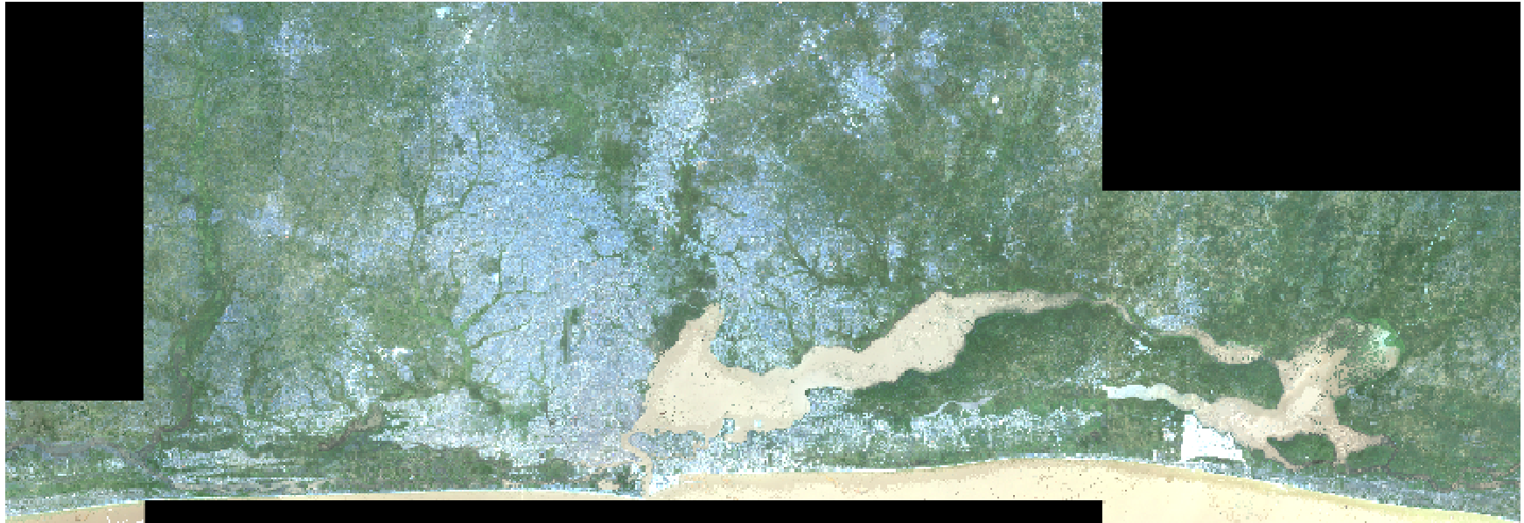
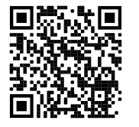
Table of Contents
Original Raw Image of Lagos, Nigeria
Introduction (3-5)
Problem statement
Data
Flow of Analysis
Contextual Features (6-24)
Extraction/Preprocessing
Feature Importance
Feature Ranking
Model Development
Covariates (25-46)
Extraction/Preprocessing
Feature Importance
Feature Ranking
Statistical Analysis
Model Development
4) Conclusion (47-52)
5) Discussion (53-55)
QR code to our github

Slide 3
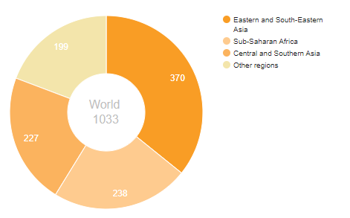
Problem Statement
Background:
According to the UN, more than 1 billion people are living in deprived areas
Policy makers, government and global organizations are seeking detailed identification of deprived areas to enhance assignment of resources and track progress of development projects
There were two questions the researchers hoped to address in this study:
1. Can feature importance methods derive any contextual or covariate features that are useful in identifying ‘Deprive’ and ‘Built-up’ areas?
2. Through the use of classical machine learning models and statistical analysis, are contextual and/or covariate features useful in identifying ‘Deprived’ and ‘Built-up’ areas?
*https://unstats.un.org/sdgs/report/2019/goal-11/

Slide 4
The Data
Labeled Areas
Raw Satellite Image
Contextual Features
Covariate Features
47,560 labeled areas in Lagos
Three labels: Deprived, Built-up and Non-Built-up
10 m² per label
Highly imbalanced
GeoTiff file for Lagos
144 contextual features
GeoTiff file per each feature
Pixel based
Format: GeoTiff file

Slide 5
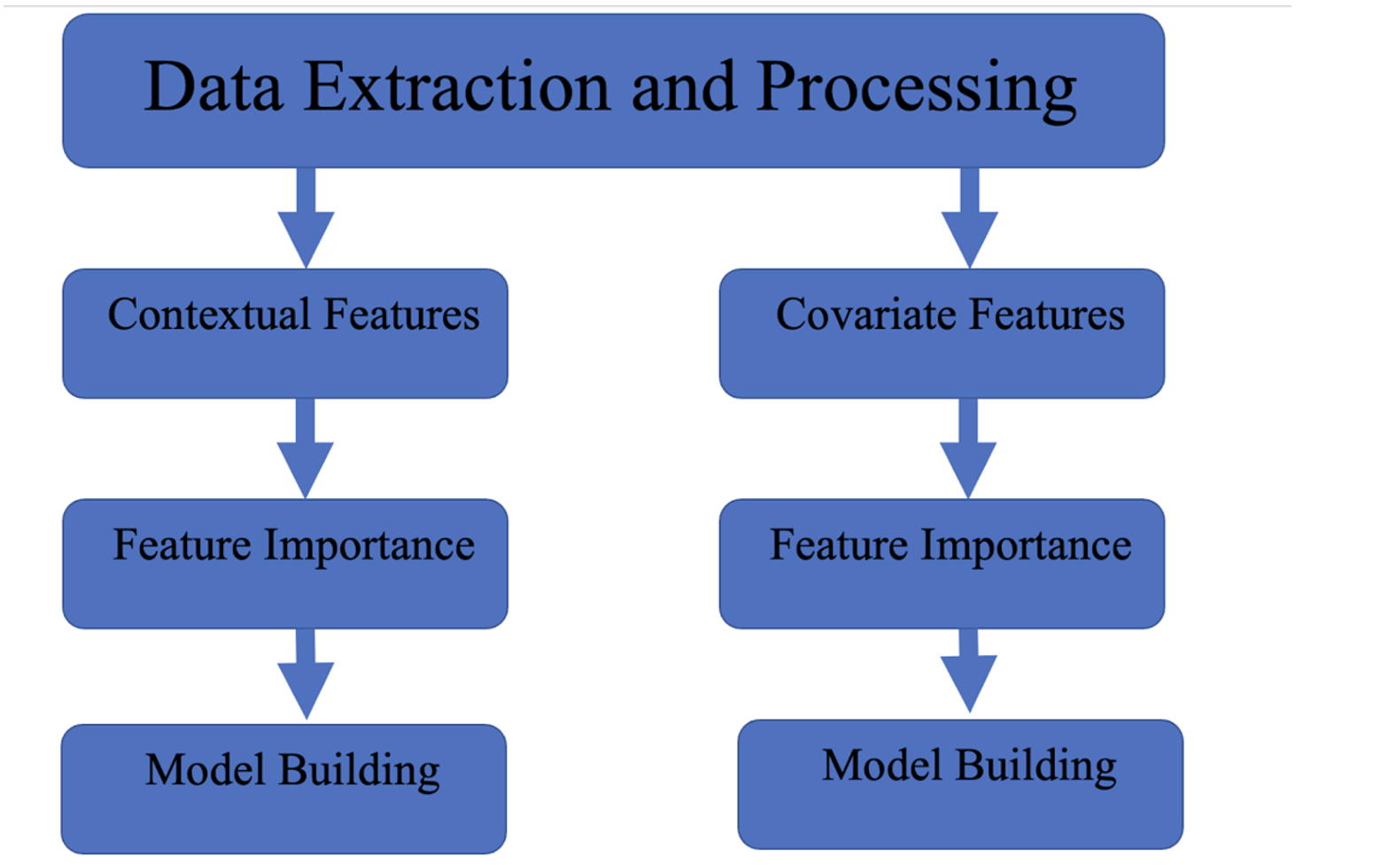
Flow of Analysis
Contextual and Covariate features followed the same:
Preprocessing
Feature importance procedure
Model building method
Standardized and split on 60/20/20
Same hyperparameter features and cross validation
Random state = 42
Alpha = 0.05

Slide 6
Contextual Features

Slide 7
Table of Contents
Introduction (3-5)
Problem statement
Data
Flow of Analysis
Contextual Features (6-24)
Extraction/Preprocessing
Feature Importance
Feature Ranking
Model Development
Covariates (25-46)
Extraction/Preprocessing
Feature Importance
Feature Ranking
Statistical Analysis
Model Development
4) Conclusion (47-52)
5) Discussion (53-55)
Original Raw Image of Lagos, Nigeria

Slide 8
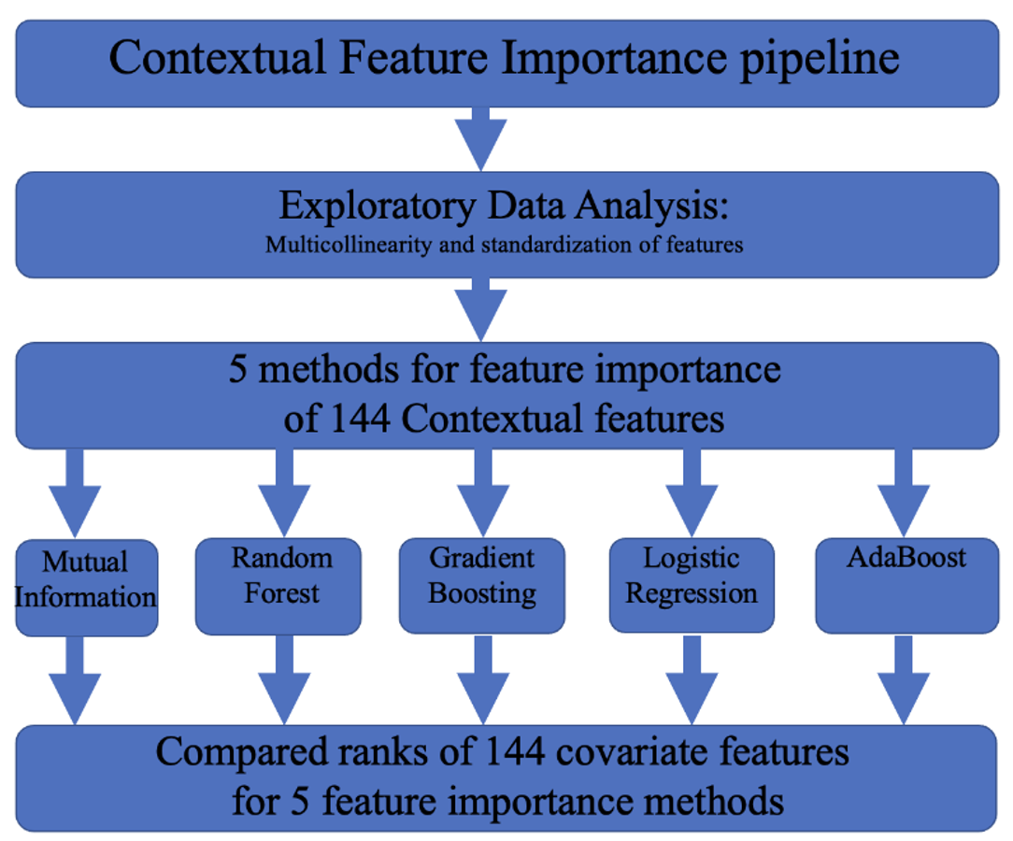
Flow of Contextual Feature Importance Analysis

Slide 9
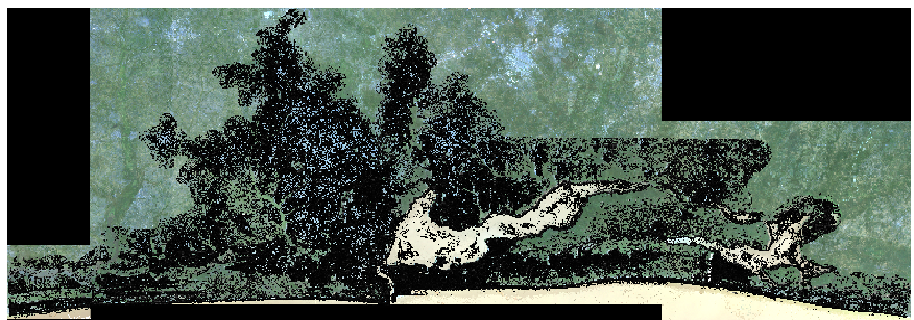
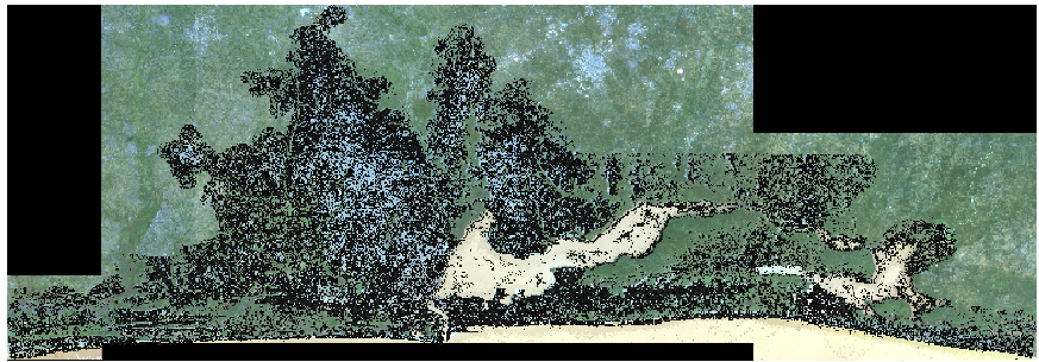
Extracting Contextual Features (Terminology)
Contextual features-144 statistical measurements for each pixel taken from satellite imaging
Contextual features were defined as the statistical quantification of edge patterns, pixel groups, gaps, textures, and the raw spectral signatures calculated over groups of pixels or neighborhoods.
Examples:
Final dataset (144 columns and 47560 rows)
sfs_sc31_w_mean
pantex_sc7_min

Slide 10
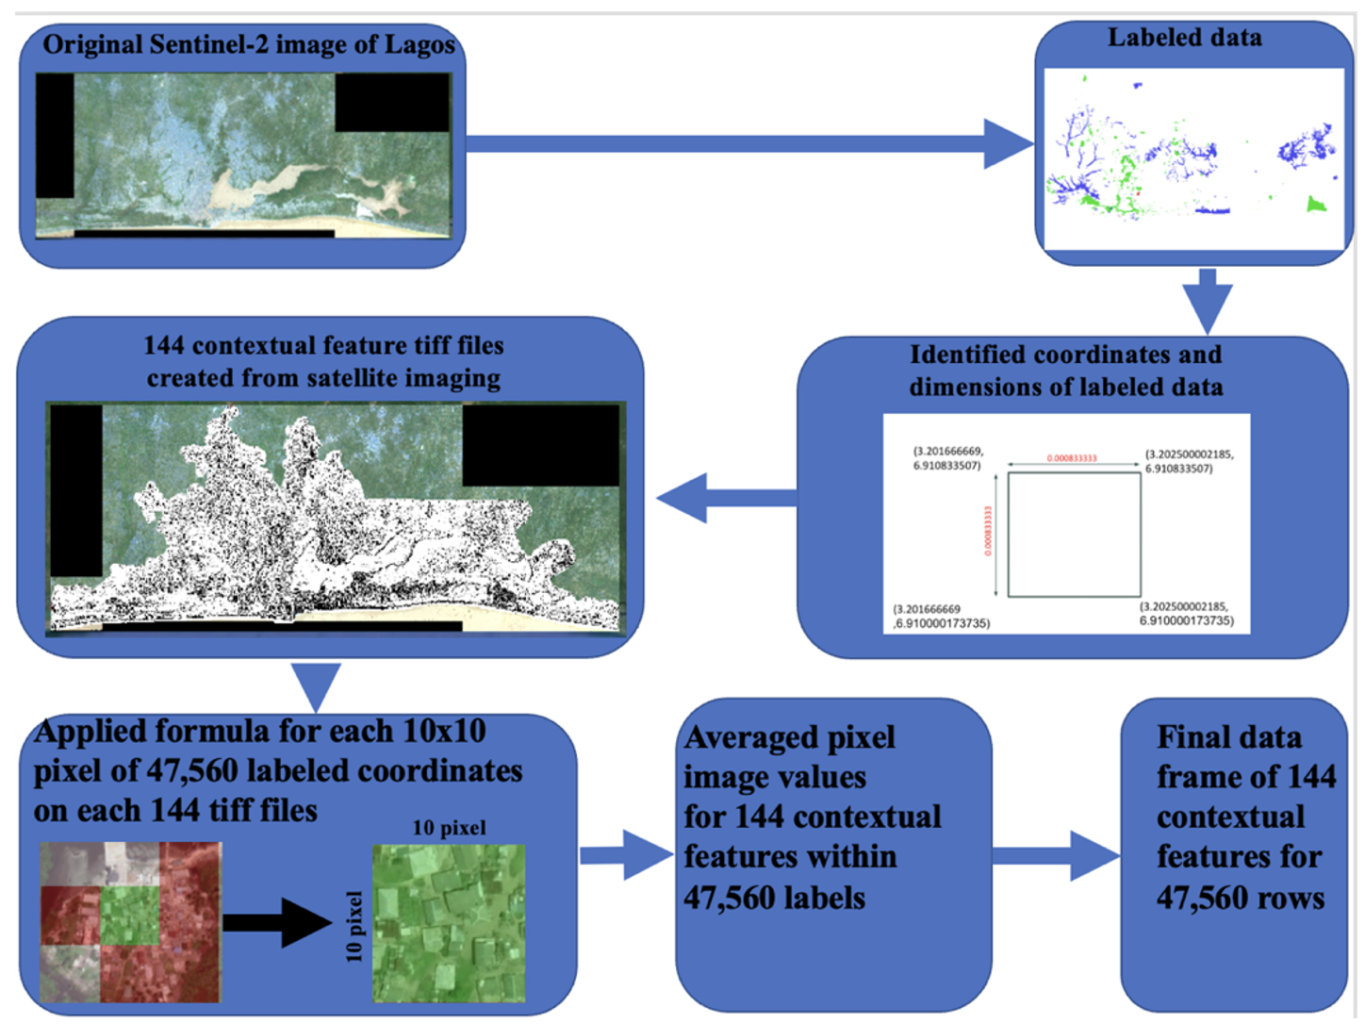
Extracting
Contextual
Features
Notes:
Talking about extracting coordinates for contextual features
The training coordinates did not cover the 100 pixels within one label. Therefore, We first calculate the center coordinates of the 100 pixels for each label. Then, this is followed by using the rasterio library to extract the contextual feature value for the corresponding coordinates. This is conducted to all the contextual features tiff files. This file will output 144 csv files
Merging coordinates for contextual features
Each 100 points correspond to one labeled data. Before merging with the labeled data file, We label each 100 points with the corresponding point number. The mean of the values for these point is then computed. Finally, We merge the contextual features dataframe with the labeled dataframe. The output of this code is one csv file containing the labeled training data and the corresponding 144 contextual features columns.

Slide 11
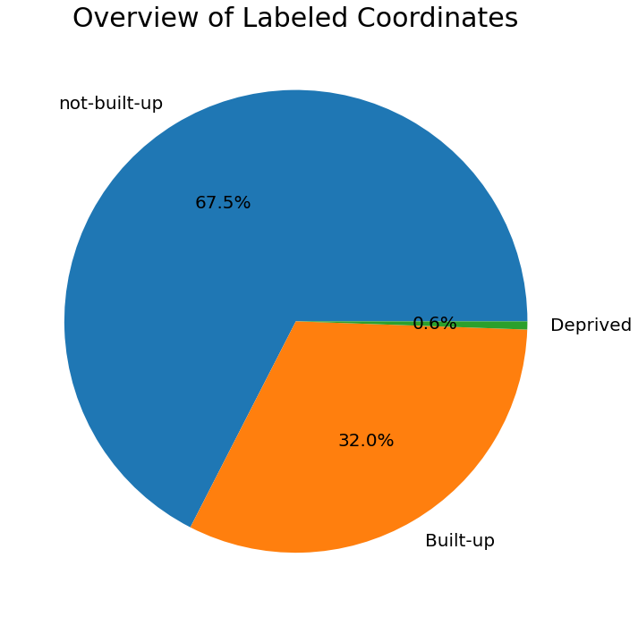
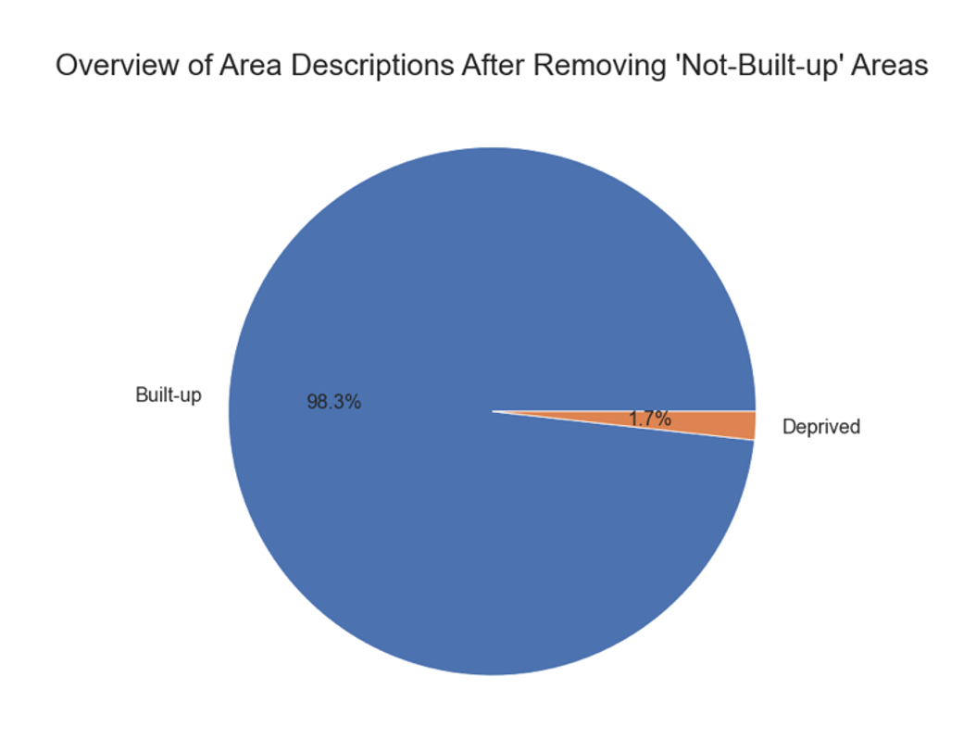
Preprocessing the Contextual Features (2/2)
Removed ‘Not-Built-up’ from the dataset
New dataframe:
15471 samples
98.3% - ‘Built-up’
1.7% - ‘Deprived’
Final dataset (144 columns and 47560 rows)

Slide 12
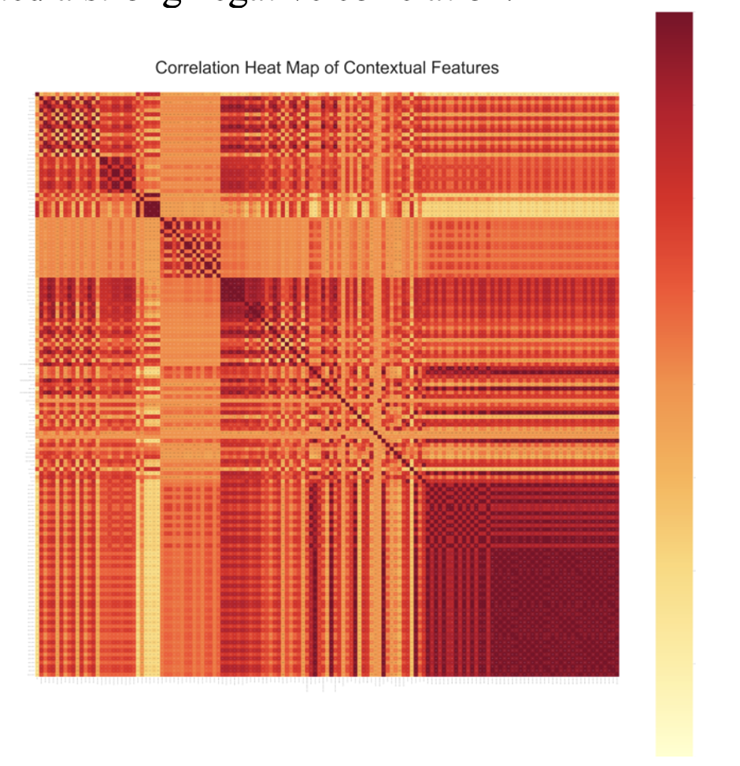
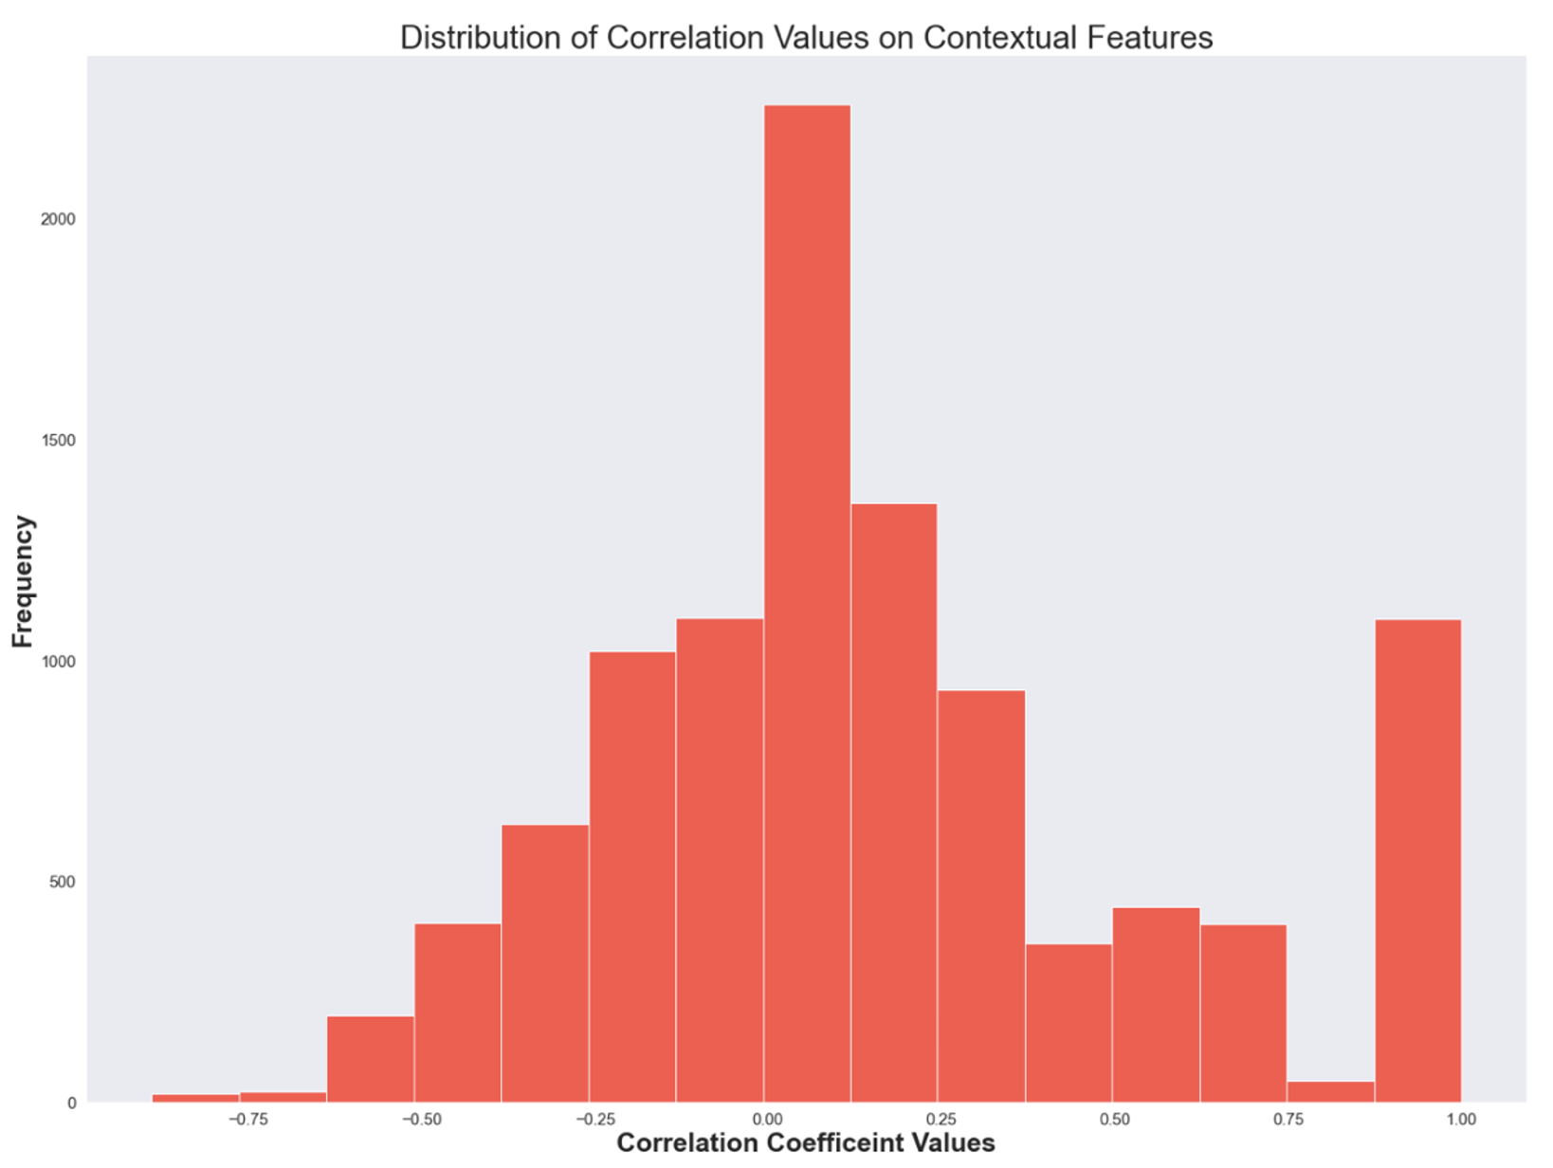
Contextual Features Correlation Plot
Many of the variables had a strong correlation with each other as indicated by dark red and light-yellow areas
Histogram showed strong negative and positive correlation
Many features had low correlation with each other (skew = 0.579909)

Slide 13
Feature Importance: Methodology
Feature Importance Method | Sklearn Function | Methodology
Mutual Information | SelectKBest, mutual_info_classif | nonparametric methods related to entropy estimation from k-nearest neighbors distances. Mutual information is closely related to entropy and provides results from the range of zero to 1.
Random Forest | feature_importances_ | The mean and standard deviation of accumulation of the impurity decrease within each decision tree of the random forest
Logistic Regression | LogisticRegression | odds ratio for coefficients
Gradient Boosting | feature_importances_ | rank features based on the total reduction of the criterion within each feature (Gini importance)
Adaboost | feature_importances_ | rank features based on the total reduction of the criterion within each feature (Gini importance)
Notes:
Gini importance
The sum over the number of splits (across all trees) that include the feature, proportionally to the number of samples it splits

Slide 14
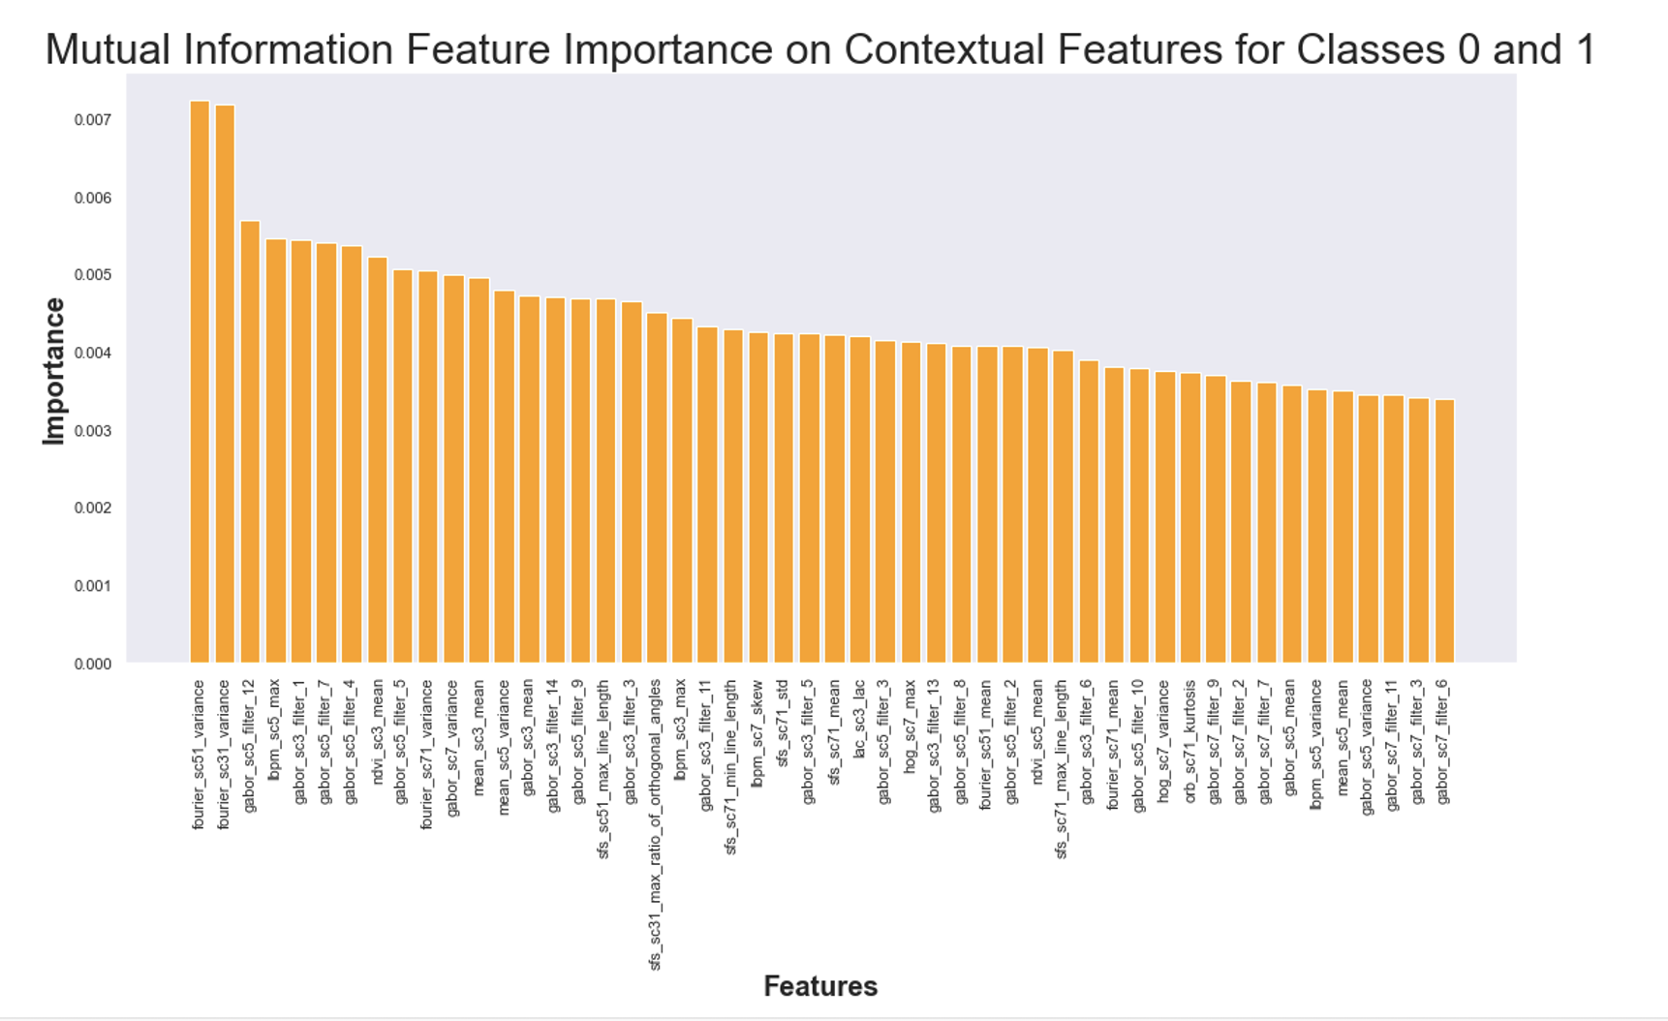
Feature Ranking: Mutual Information
Feature importance conducted on validation set
Most significant feature:
‘fourier_sc51_variance’

Slide 15
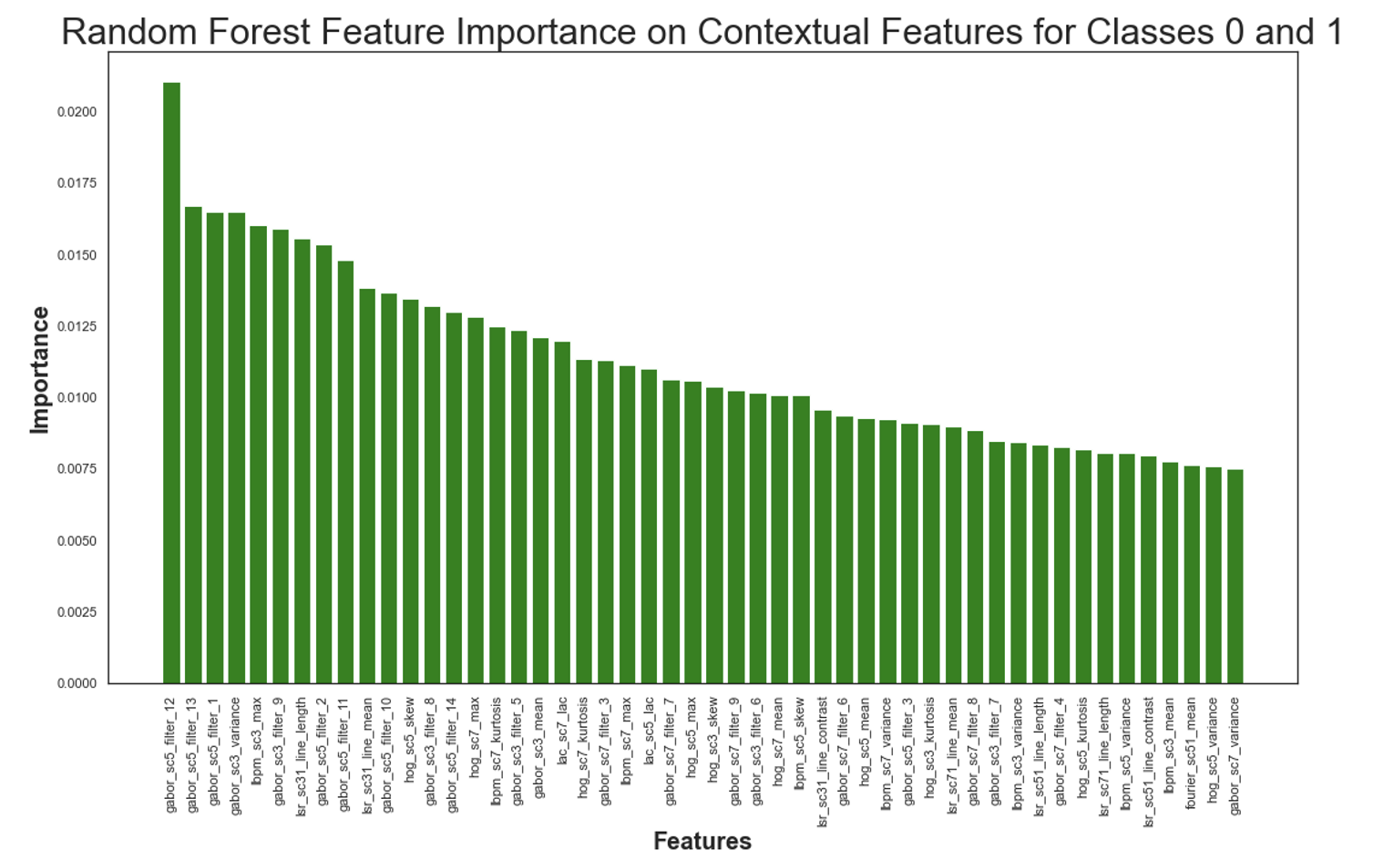
Feature Ranking: Random Forest
Feature importance conducted on validation set
Most significant feature: ‘gabor_sc5_filter_12’

Slide 16
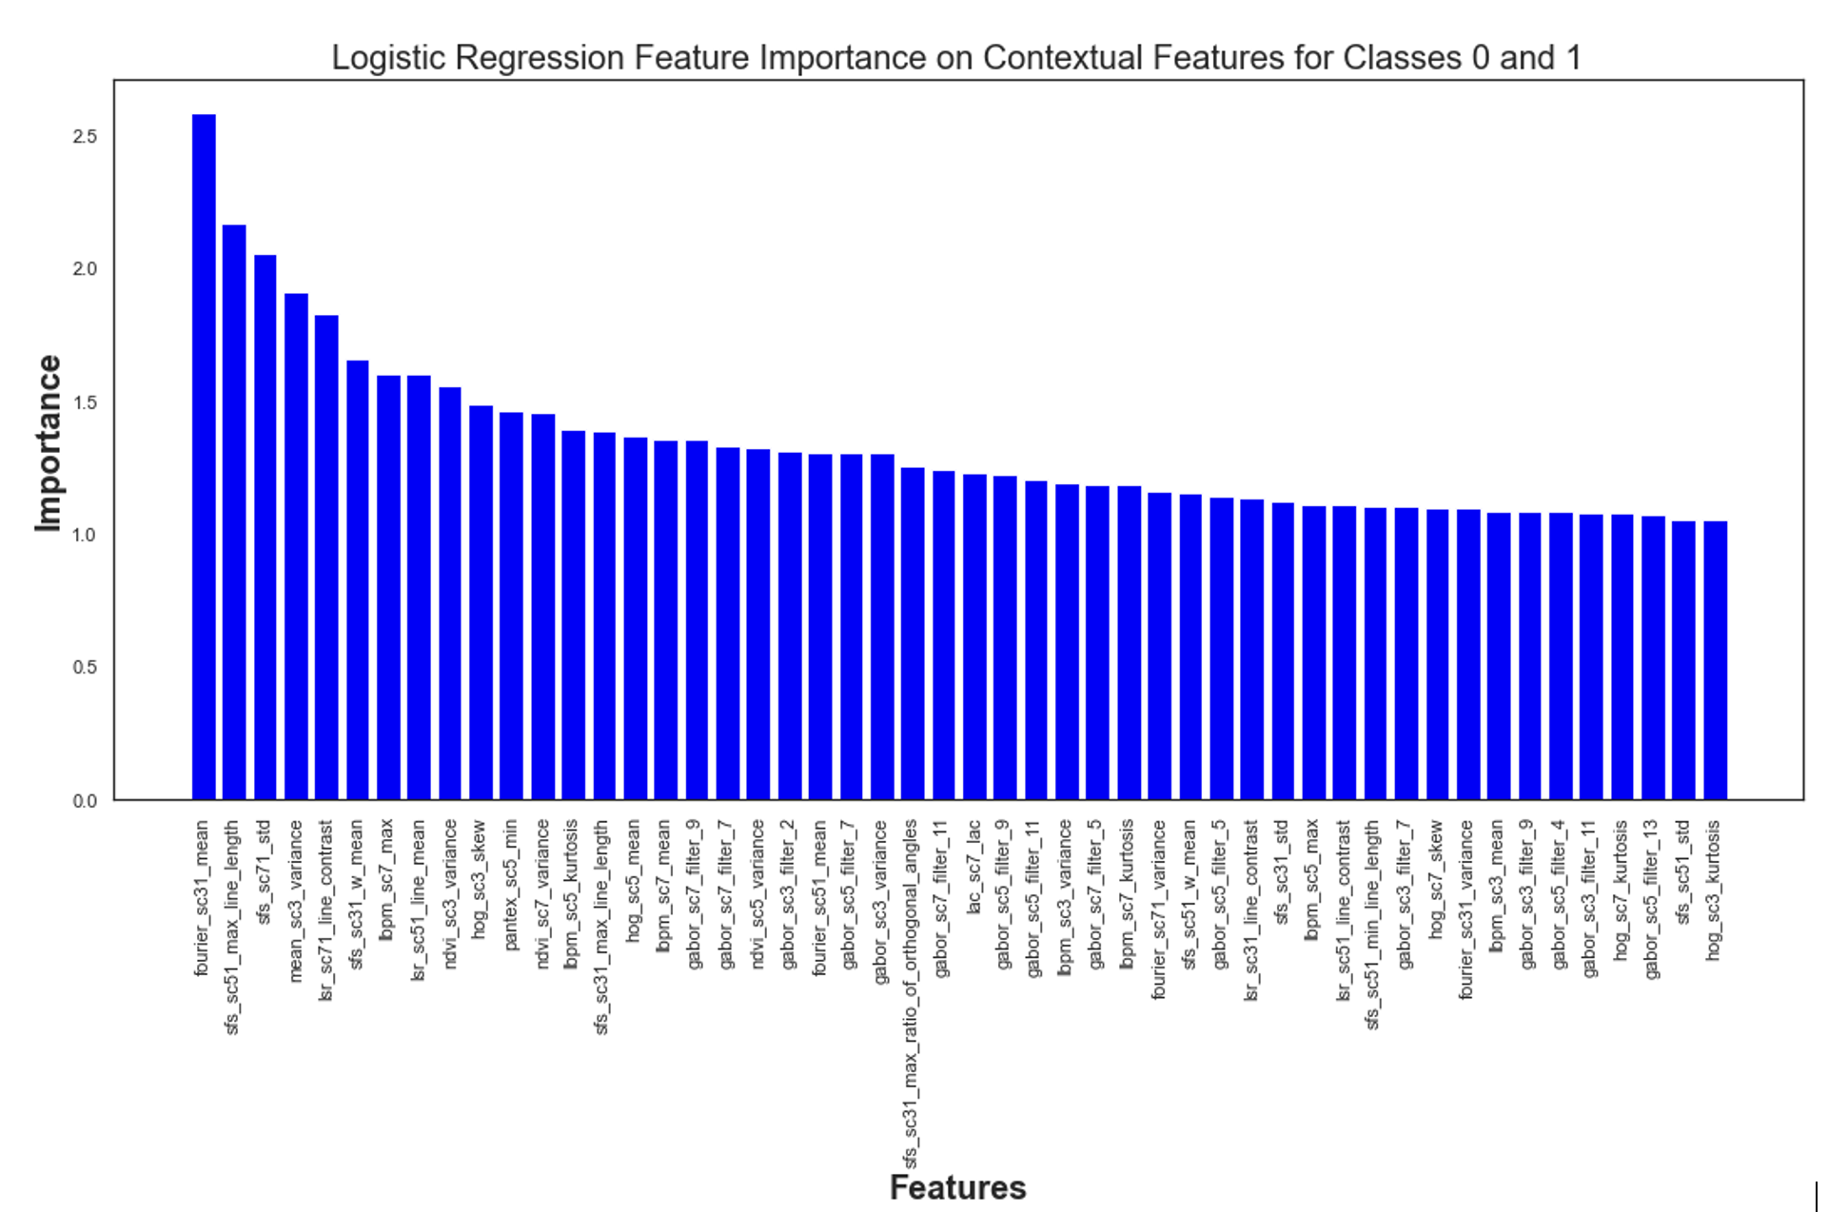
Feature Ranking: Logistic Regression
Feature importance conducted on Validation set
Most significant feature:
‘fourier_sc31_mean’

Slide 17
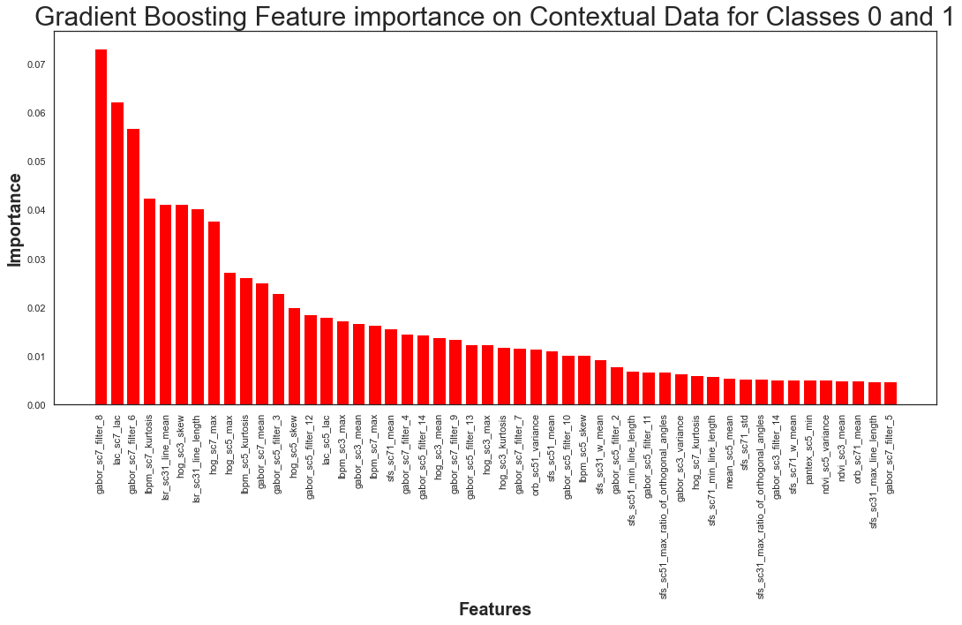
Feature Ranking: Gradient Boosting
Feature importance conducted on Validation set
Most significant feature:
‘gabor_sc7_filter_8’

Slide 18
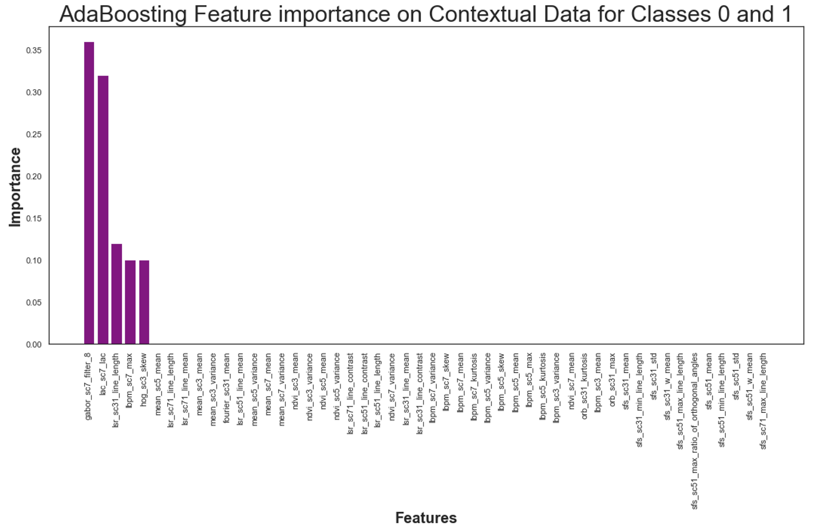
Feature Ranking: Adaptive Boosting
Feature importance conducted on Validation set
If feature was not significant, it was given value of zero
5 features were important
Most significant feature:
‘gabor_sc7_filter_8

Slide 19
Feature Ranking: Results
No clear pattern was detected amongst Contextual Feature methods
Feature with rank 1: ‘lbpm_sc7_max’
Model | Validation F1 for ‘Deprived’
Random Forest | 0.07
Logistic Regression | 0.07
Gradient Boosting | 0.00
Adaboost | 0.00

Slide 20
Feature Ranking: Comparing all Ranks
Contextual features would have feature importance values for some models but have low values for others
Contextual_ features | top_logistic _0_1 | top_ Random _Forest_0_1 | top_ Gradient_ Boosting_0_1 | top_ Ada _Boosting_0_1 | minfo_0_1 | rank
lbpm_sc7_max | 7 | 22 | 18 | 4 | 39 | 1
hog_sc3_skew | 10 | 26 | 6 | 5 | 73 | 2
gabor_sc5_filter_12 | 69 | 1 | 14 | 82 | 3 | 3
lac_sc7_lac | 26 | 19 | 2 | 2 | 131 | 4
gabor_sc7_filter_8 | 91 | 38 | 1 | 1 | 53 | 5

Slide 21
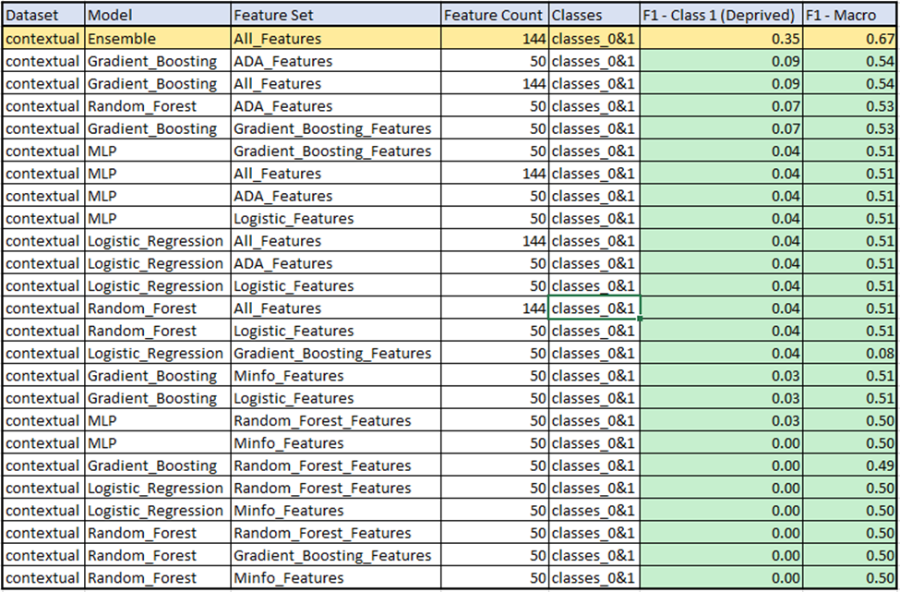
Model Development: Contextual - classes 0 & 1
5 model types tested:
Ensemble (9 MLP models)
Multilayer Perceptron
Random Forest
LogisticRegression
Gradient Boosting
train/test/val split: 60/20/20
GridsearchCV used for hyperparameter tuning
Top 50 features in each feature reduction set tested
Best performing model:
Ensemble model
Using all features available

Slide 22
Best Model: Contextual - classes 0 & 1
Best Performing Contextual Model on All Classes
Model Parameters
Hidden layer sizes: (100, 100, 100)
Number of neurons in hidden layer
Activation: tanh
the hyperbolic tan function, returns f(x) = tanh(x)
Solver: adam
refers to a stochastic gradient-based optimizer proposed by Kingma, Diederik, and Jimmy Ba
Alpha: 0.0001
L2 penalty (regularization term) parameter
Learning Rate: invscaling
gradually decreases the learning rate at each time step ‘t’ using an inverse scaling exponent of ‘power_t’. effective_learning_rate = learning_rate_init / pow(t, power_t)
Dataset | Model | Feature Set | Feature Count | Classes | F1- Deprived | F1- Macro
Contextual | Ensemble | All | 144 | classes 0&1 | 0.35 | 0.67
Ensemble model consisted of nine (9) MLP models
Contextual Confusion Matrix - Classes 0 & 1
True | Built-up | 3033 | 9
 | Deprived | 39 | 13
 |  | Built-up | Deprived
 | Predicted
(Confusion Matrix for the best performing model trained on the contextual features dataset containing only instances of the built-up (0) and deprived (1) classes.)

Slide 23
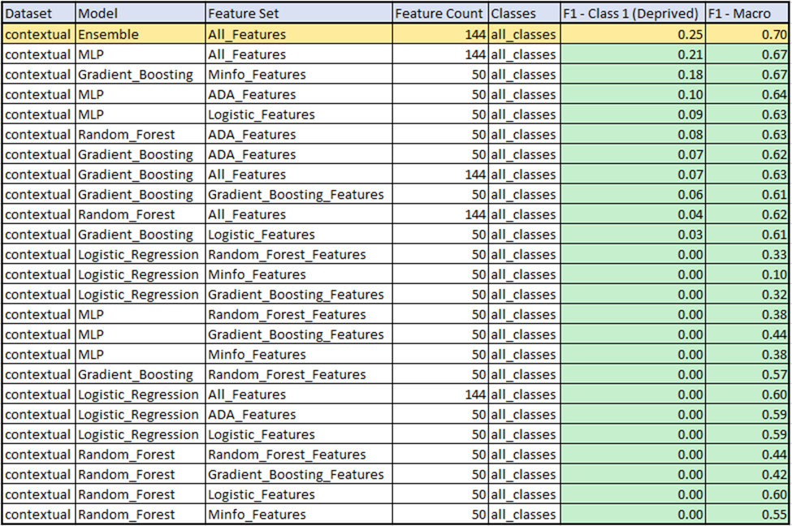
Model Testing: Contextual - all classes
5 model types tested:
Ensemble (9 MLP models)
Multilayer Perceptron
Random Forest
LogisticRegression
Gradient Boosting
train/test/val split: 60/20/20
GridsearchCV used for hyperparameter tuning
Top 50 features in each feature reduction set tested
Best performing model:
Ensemble model
Using all features available

Slide 24
Best Model: Contextual - all classes
Best Performing Contextual Model on All Classes
Model Parameters
Hidden layer sizes: (100, 100, 100)
Number of neurons in hidden layer
Activation: tanh
the hyperbolic tan function, returns f(x) = tanh(x)
Solver: adam
refers to a stochastic gradient-based optimizer proposed by Kingma, Diederik, and Jimmy Ba
Alpha: 0.0001
L2 penalty (regularization term) parameter
Learning Rate: invscaling
gradually decreases the learning rate at each time step ‘t’ using an inverse scaling exponent of ‘power_t’. effective_learning_rate = learning_rate_init / pow(t, power_t)
Dataset | Model | Feature Set | Feature Count | Classes | F1- Deprived | F1- Macro
Contextual | Ensemble | All | 144 | all classes | 0.25 | 0.70
Ensemble model consisted of nine (9) MLP models
Contextual Confusion Matrix - All Classes
True | Built-up | 2729 | 6 | 325
 | Deprived | 25 | 8 | 16
 | Non-built-up | 267 | 1 | 6138
 |  | Built-up | Deprived | Non-built-up
 | Predicted
(Confusion Matrix for the best performing model trained on the full contextual features dataset containing all instances of the Built-up (0), Deprived (1), and Non-built-up (2) classes )

Slide 25
Covariate Features

Slide 26
Table of Contents
Introduction (3-5)
Problem statement
Data
Flow of Analysis
Contextual Features (6-24)
Extraction/Preprocessing
Feature Importance
Feature Ranking
Model Development
Covariates (25-46)
Extraction/Preprocessing
Feature Importance
Feature Ranking
Statistical Analysis
Model Development
4) Conclusion (47-52)
5) Discussion (53-55)
Original Raw Image of Lagos, Nigeria

Slide 27
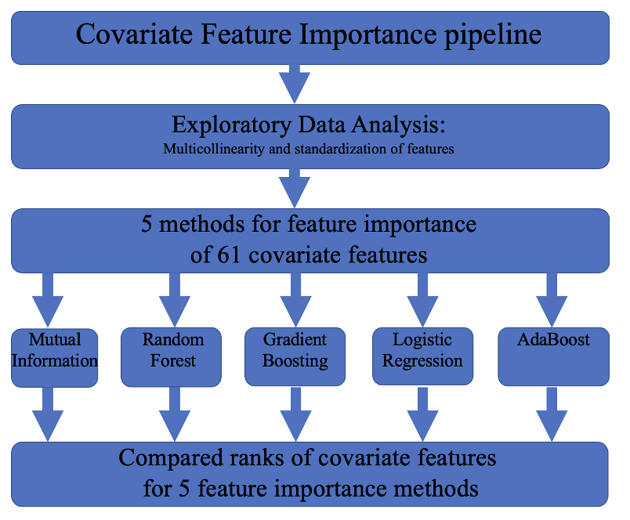
Flow of Covariate Feature Importance Analysis

Slide 28
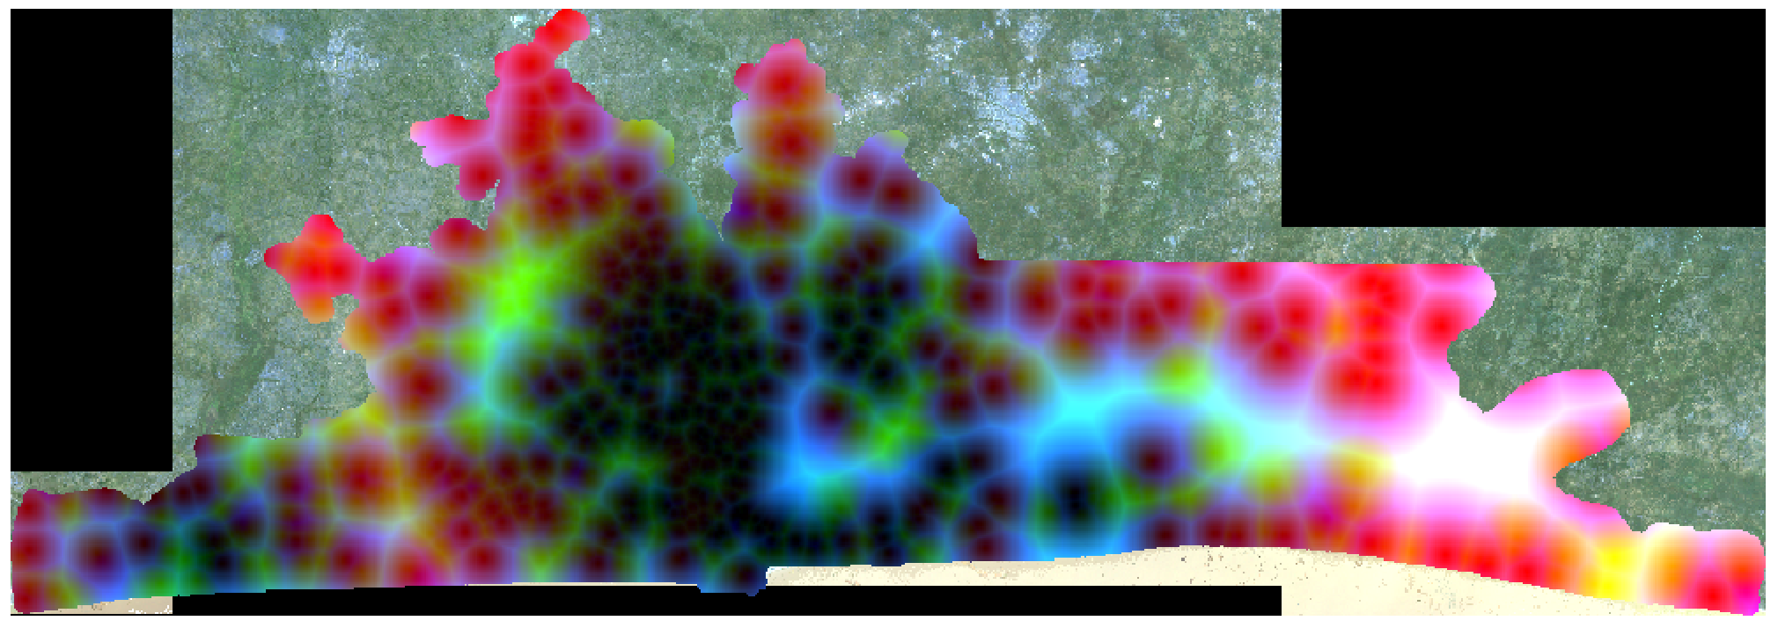
Extracting Covariate Features (Terminology)
Covariate features- 61 total:
Features stored in a single geoTiff file
55 continuous variables
6 categorical variables
Final dataset (144 columns and 47560 rows)
Covariate Feature | Count
Facilities & Services | 8
Housing(HO) | 1
Infrastructure | 5
Physical Hazards & Assets | 23
Population Counts | 2
SES(HH) | 14
Social Hazards and Assets | 5
Unplanned Urbanization | 3
Covariate Features
Notes:
These feature values were sourced from various open-source and government sources such as humdata.org, worldpop.org, geopode.org, spatialdatya.dhsprogram.com, and more

Slide 29
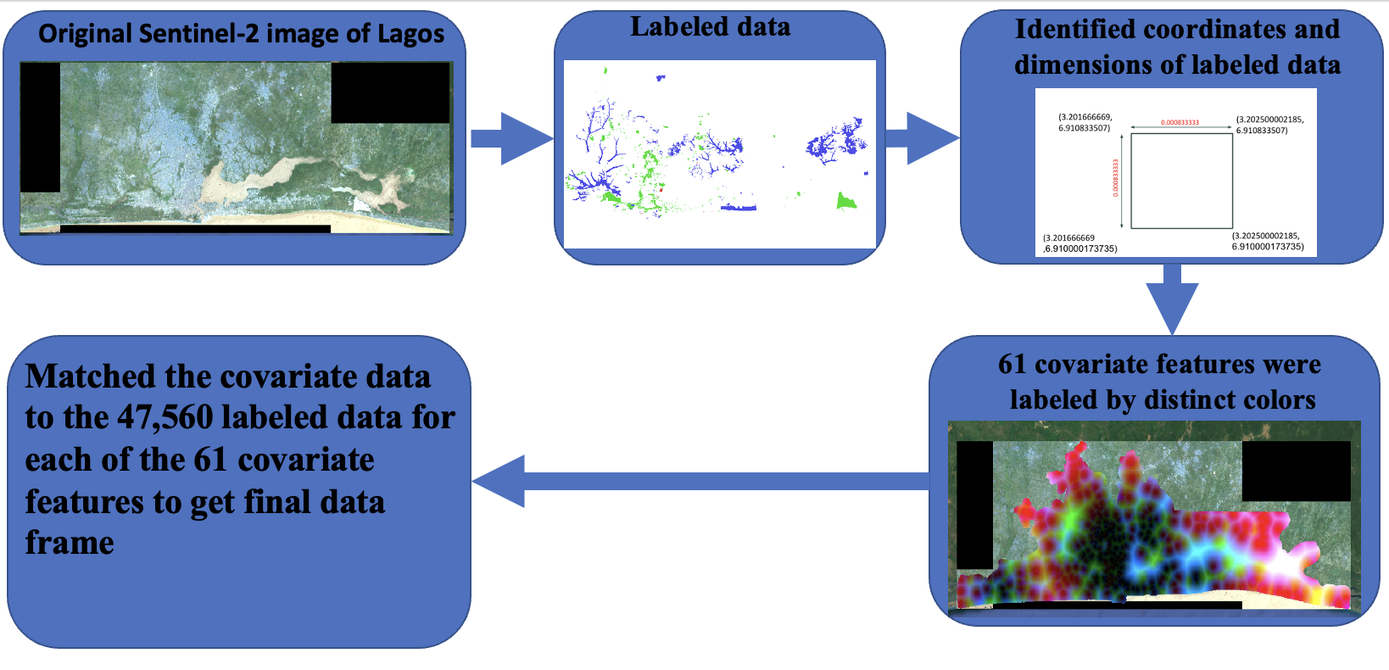
Extracting Covariate Features
Notes:
Covariate Features
all covariate features were extracted for each labeled data point. The extraction output in the form of one column. Each column contained 61 values in a string structure. Therefore, further processing was conducted to have an output ready for modeling. This file outputs one csv containing the labeled data and 61 covariate features columns.

Slide 30
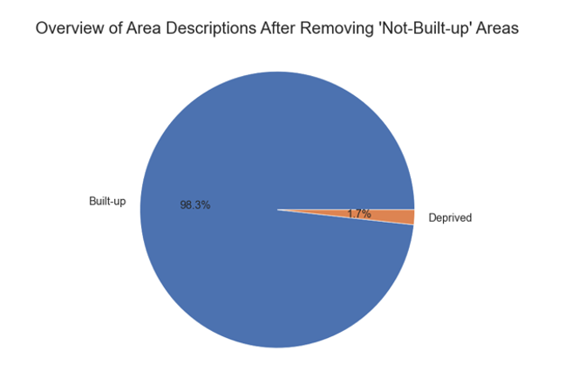
Preprocessing the Covariate Features
Removed 1987 nan values
1876 from ‘Not-Built-up’
1 from ‘Built-up’
Removed ‘ph_gdmhz_2005’
Contained nan values
Removed ‘Not-Built-up’ from the dataset
New dataframe:
15470 samples
98.3% - ‘Built-up’
1.7% - ‘Deprived’
Final dataset (144 columns and 47560 rows)

Slide 31
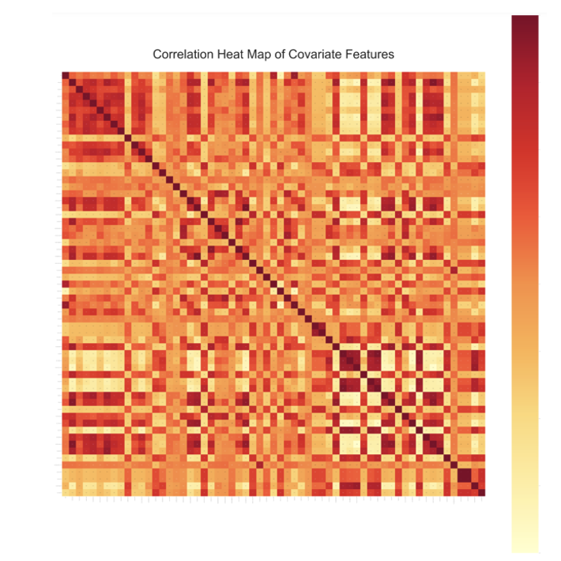
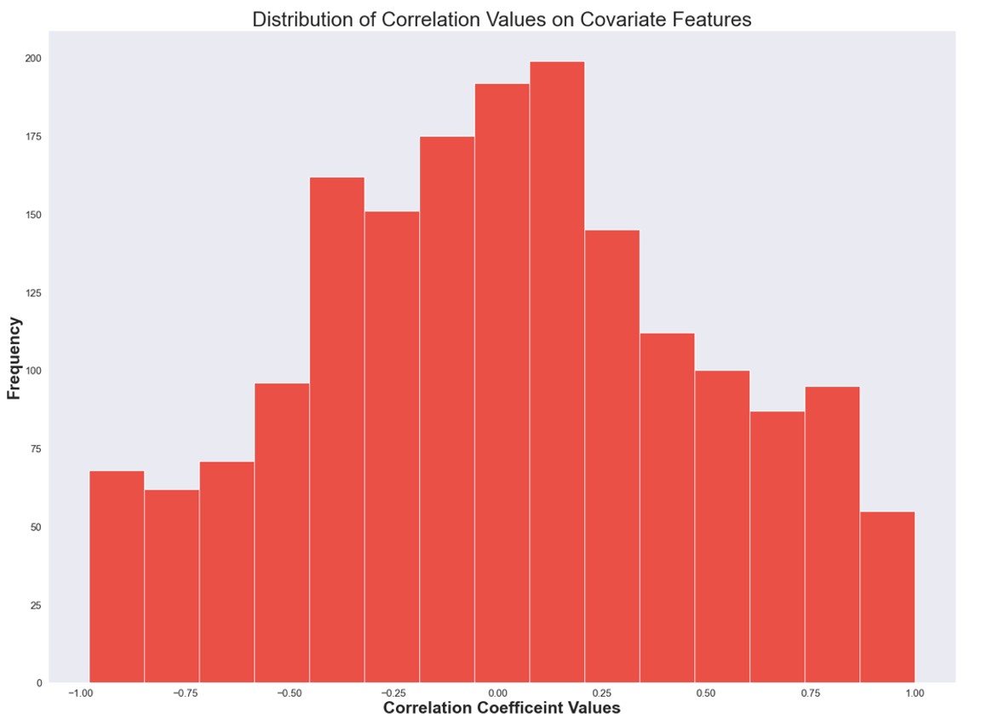
Covariate Features Correlation Plot
Many of the variables had a strong correlation with each other as indicated by dark red and light-yellow areas
Histogram showed strong negative and positive correlation
Many features had low correlation with each other (skew = 0.017183)

Slide 32
Feature Importance: Methodology
Feature Importance Method | Sklearn Function | Methodology
Mutual Information | SelectKBest, mutual_info_classif | nonparametric methods related to entropy estimation from k-nearest neighbors distances. Mutual information is closely related to entropy and provides results from the range of zero to 1.
Random Forest | feature_importances_ | The mean and standard deviation of accumulation of the impurity decrease within each decision tree of the random forest
Logistic Regression | LogisticRegression | odds ratio for coefficients
Gradient Boosting | feature_importances_ | rank features based on the total reduction of the criterion within each feature (Gini importance)
Adaboost | feature_importances_ | rank features based on the total reduction of the criterion within each feature (Gini importance)

Slide 33
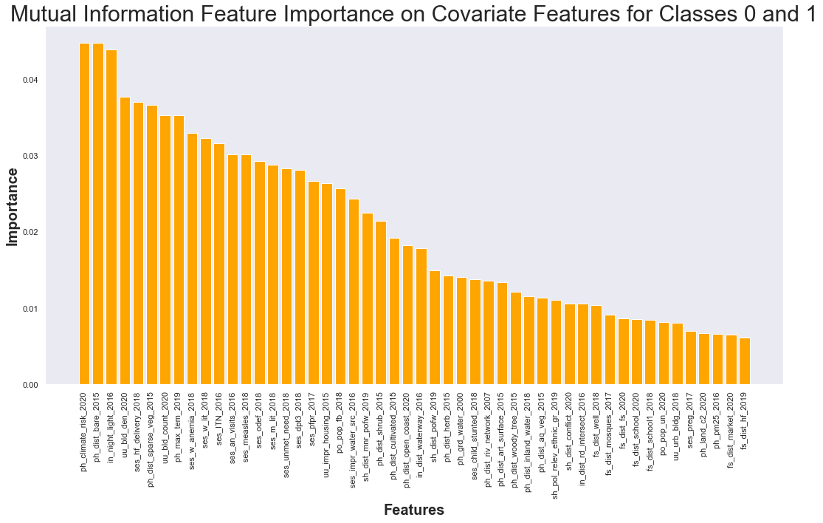
Feature Ranking: Mutual Information
Feature importance conducted on validation set
Most significant feature:
‘ph_climate_risk_2020’

Slide 34
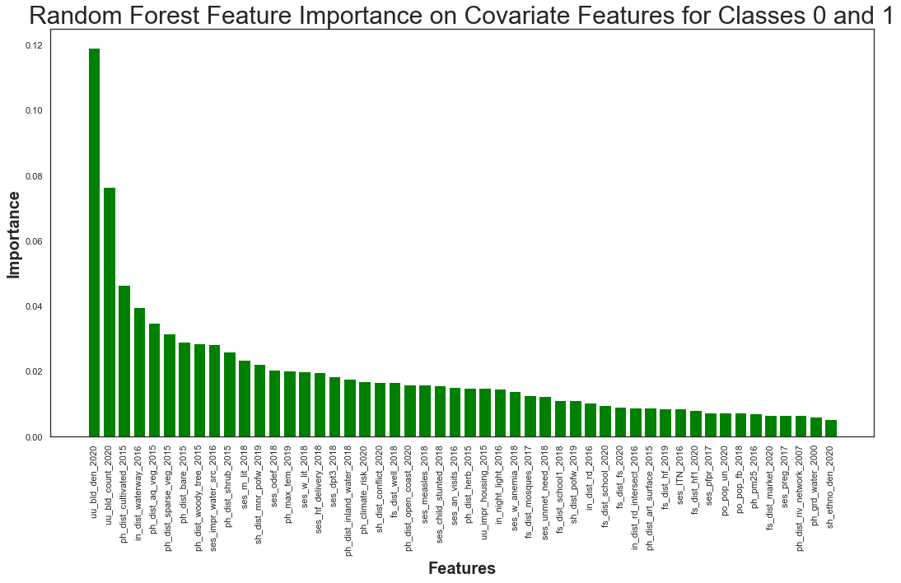
Feature Ranking: Random Forest
Feature importance conducted on validation set
Most significant feature: ‘uu_bld_den_2020’

Slide 35
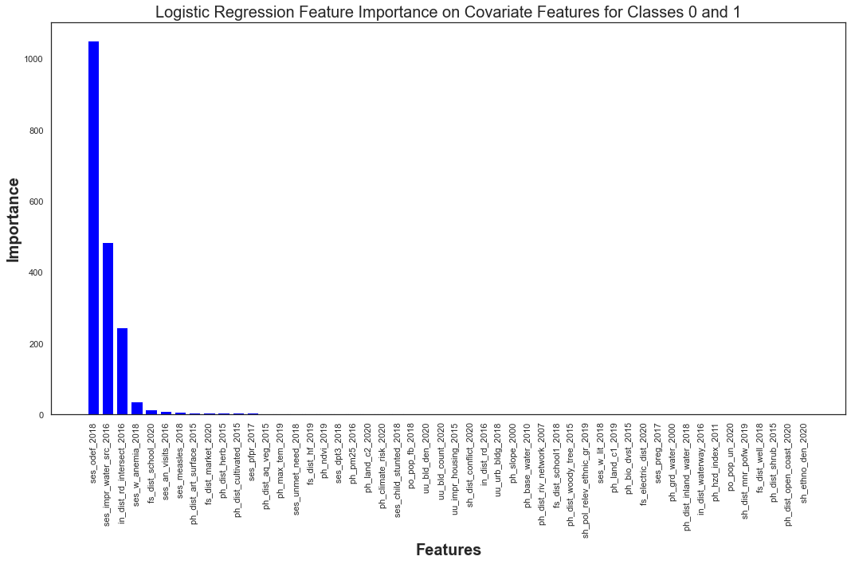
Feature Ranking: Logistic Regression
Feature importance conducted on Validation set
Most significant feature:
‘ses_odef_2018’’

Slide 36
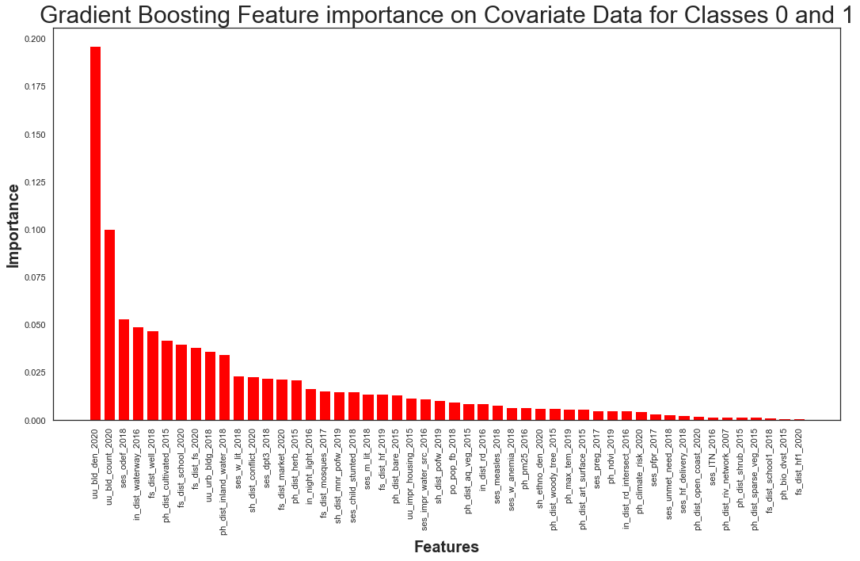
Feature Ranking: Gradient Boosting
Feature importance conducted on Validation set
Most significant feature:
‘uu_bld_den_2020’

Slide 37
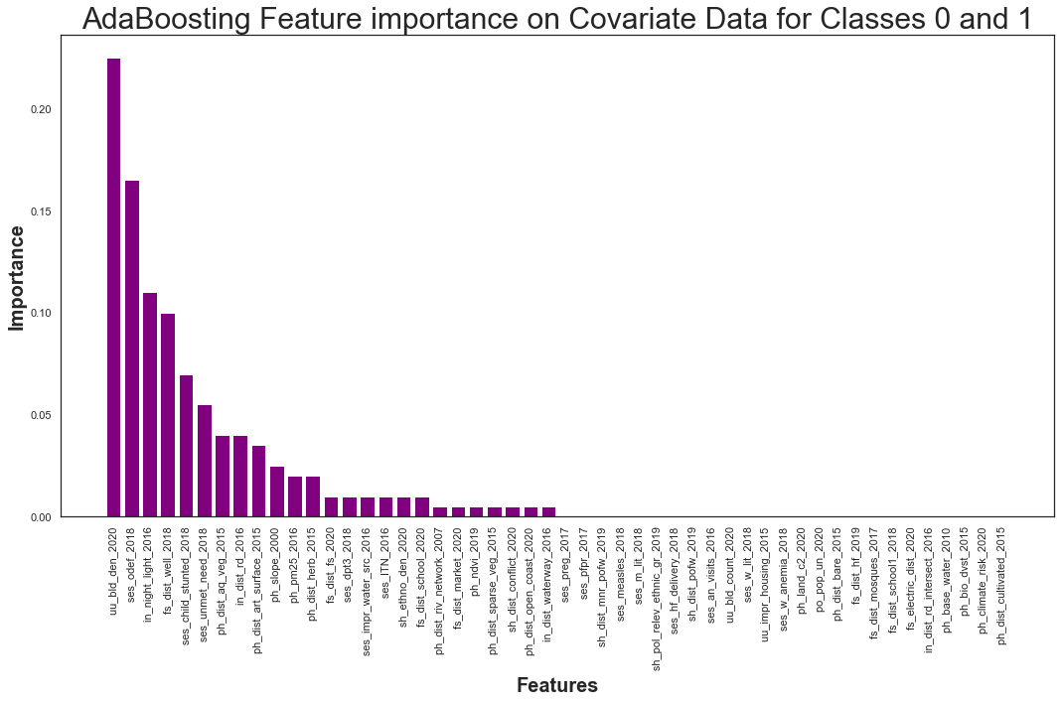
Feature Ranking: Adaptive Boosting
Feature importance conducted on Validation set
If feature was not significant, it was given value of zero
25 features were important
Most significant feature:
‘uu_bld_den_2020’

Slide 38
Feature Ranking: Results
No clear pattern was detected amongst covariate feature methods
Feature with rank 1: ‘uu_bld_den_2020’
Model | Validation F1 for ‘Deprived’
Random Forest | 0.91
Logistic Regression | 0.87
Gradient Boosting | 0.81
Adaboost | 0.79

Slide 39
Feature Ranking: Comparing all Ranks
Covariate features would have feature importance values for some models but have low values for others
Top performing feature: ‘uu_bld_den_2020’
Covariate_ features | top_ logistic_0_1 | top_ Random_ Forest_0_1 | top_ Gradient_ Boosting_0_1 | top_ Ada_ Boosting_0_1 | minfo_ 0_1 | rank
uu_bld_den_2020 | 24 | 1 | 1 | 1 | 4 | 1
ses_odef_2018 | 1 | 13 | 3 | 2 | 14 | 2
uu_bld_count_2020 | 25 | 2 | 2 | 35 | 7 | 3
ses_impr_water_src_2016 | 2 | 9 | 24 | 15 | 21 | 4
ses_dpt3_2018 | 18 | 17 | 13 | 14 | 17 | 5
ph_dist_ aq_veg_2015 | 13 | 5 | 27 | 7 | 35 | 6

Slide 40
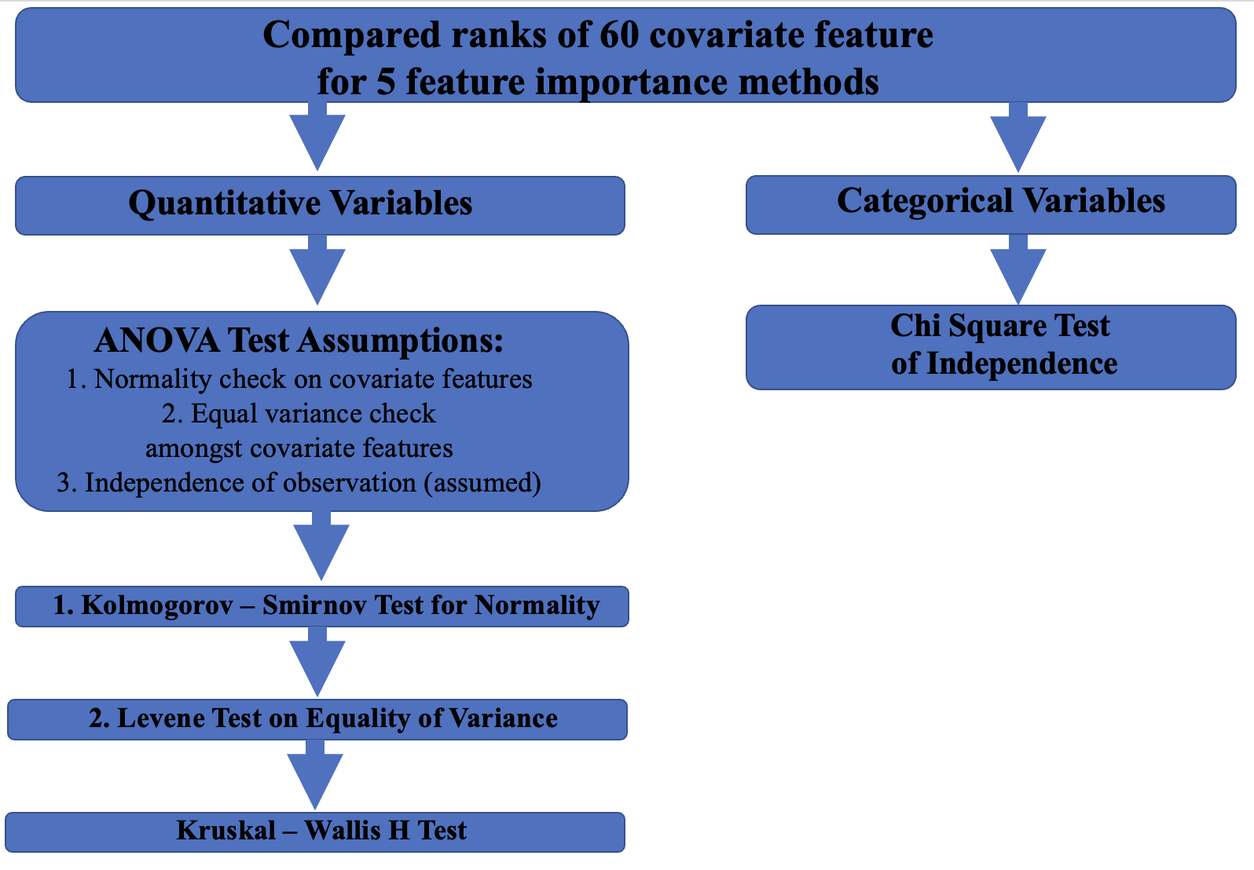
Flow of Covariate Feature Statistical Analysis

Slide 41
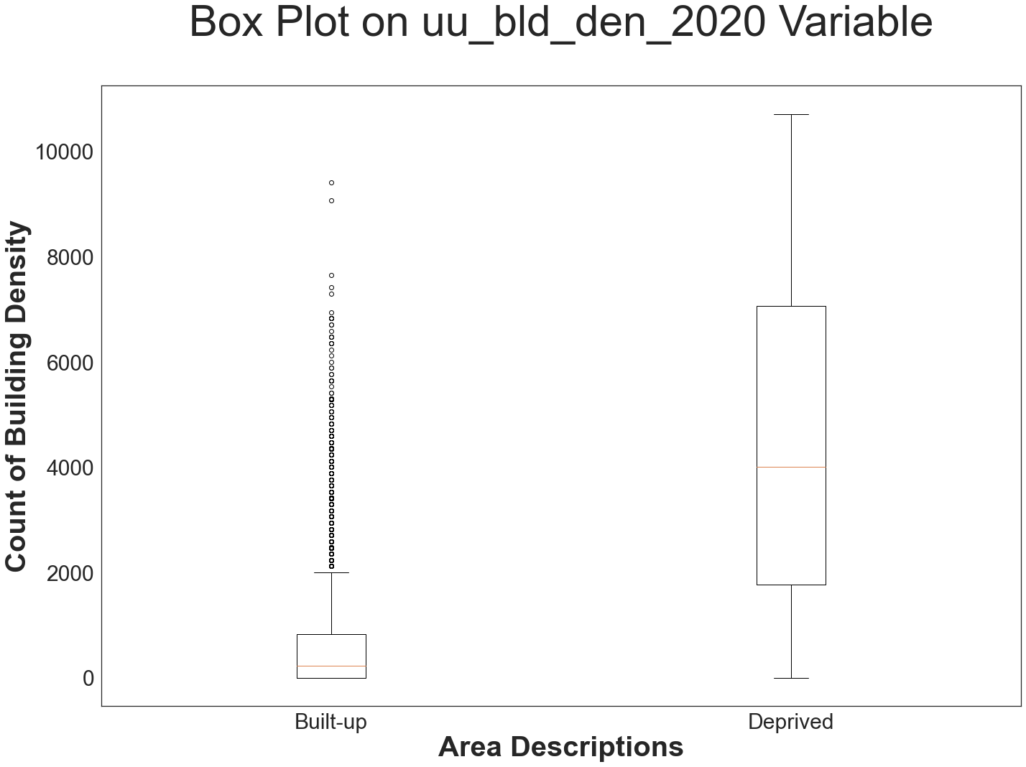
Quantitative Statistical Analysis
Results: Determined that top 21 covariate features were statistically significant in determining ‘Deprived’ and ‘Built-up’ areas
Hypothesis testing:
Kolmogorov-Smirnov test on
Normality (ANOVA assumption 1)
Levene test for equality of
variances (ANOVA assumption 2)
Kruskal-Wallis H test
Mean rank utilized for testing (link)
Non-parametric rank based testing
Box plot:
Quantiles for ‘Deprived’ and ‘Built-up’ do
not overlap (visual indication of
difference between groups)
Notes:
K-smirov test
Tests to see if values follow normal distribution
Null hypothesis values follow normal distribution
Alternative values do not follow normal distribution
Levene test
Test for equal variance
Null hypothesis variances are equal
Alternative variances are not equal
Kruskal Wallis H-test
A rank based non-parametric one-way ANOVA test used to see difference between two or more groups of independent variables
Compared the mean ranks of the values
Mean rank is the average of the ranks for all observations within each sample
If two or more observations are tied, the average rank to each tied observation
The H test refers to the the chi-square distribution approximates

Slide 42
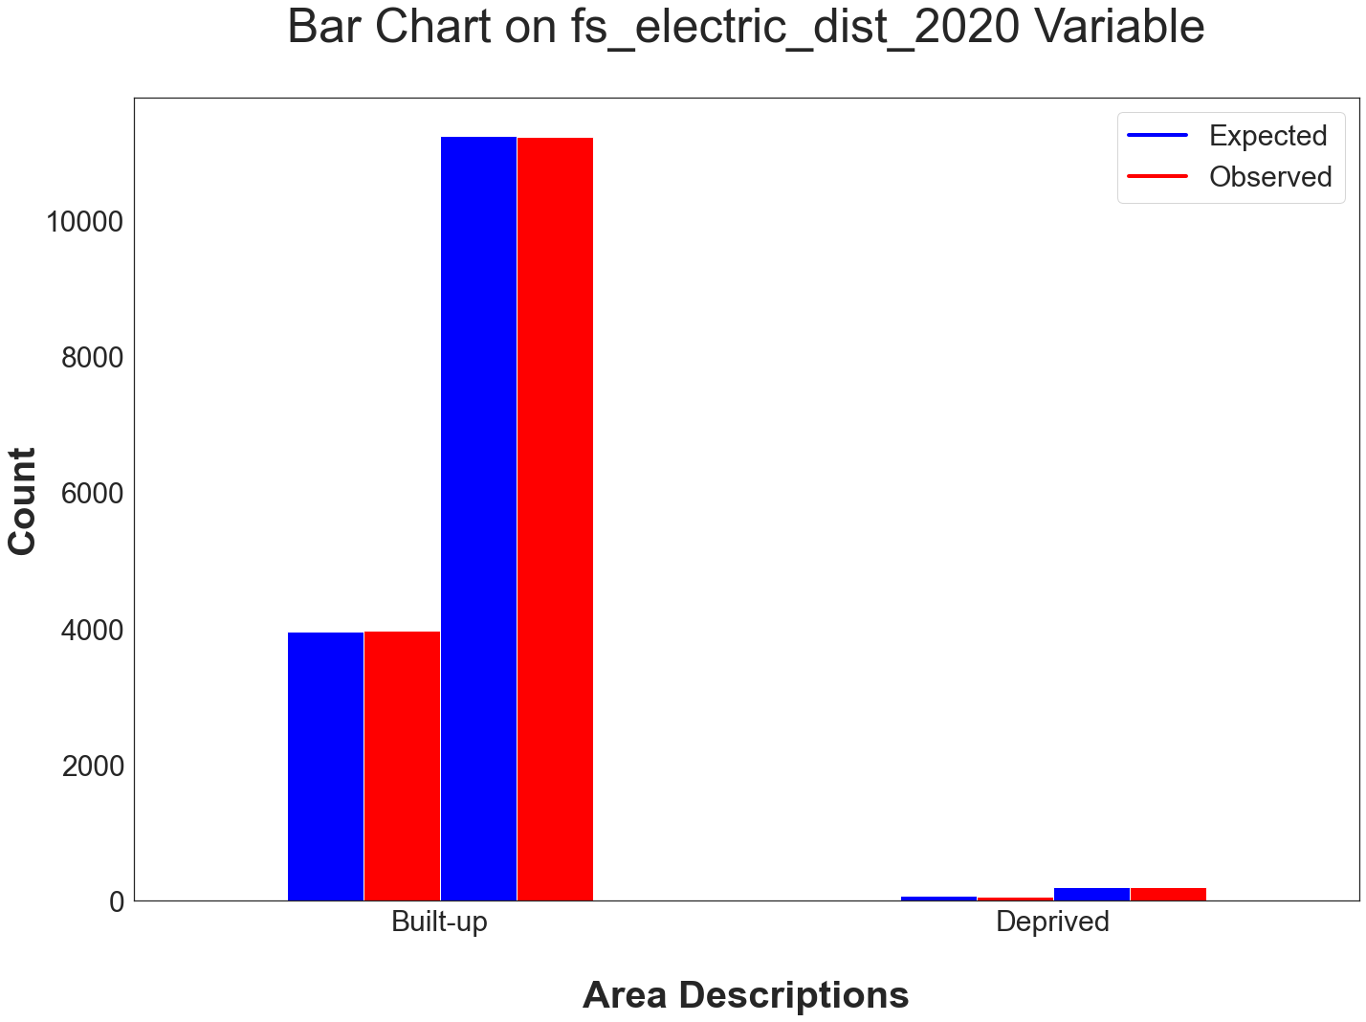
Categorical Statistical Analysis
Determined that 1 out of 5 variables was statistically independent from being able to classify ‘Deprived’ and ‘Built-up’
‘fs_electric_dist_2020’
Hypothesis testing:
Chi Square test of Independence
Chi-Square Test Results
Categorical Covariate Features | P-value | Number of categories
fs_electric_dist_2020 | 0.7381 | 2
ph_hzd_index_2011 | 0.00 | 6
ph_land_c1_2019 | 0.00 | 11
ph_land_c2_2020 | 0.00 | 8
sh_pol_relev_ethnic_gr_2019 | 0.00 | 2
uu_urb_bldg_2018 | 0.00 | 3

Slide 43
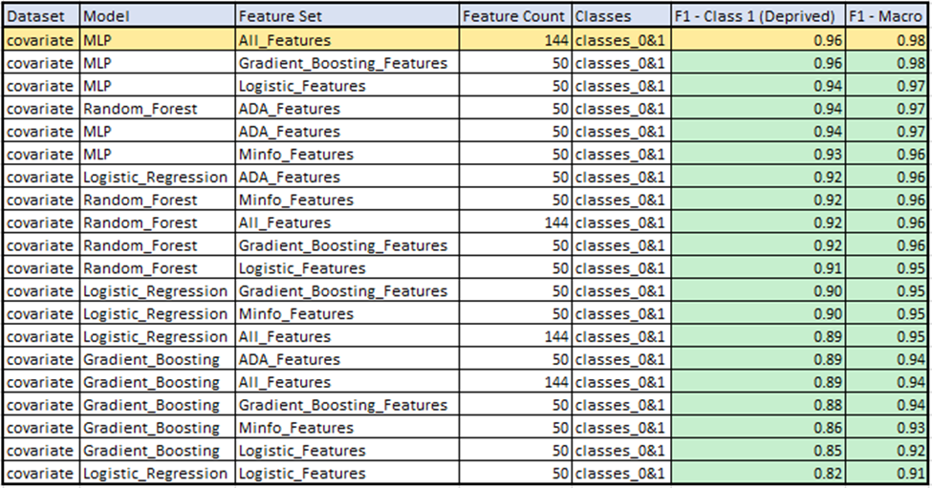
Model Testing: Covariate - classes 0 & 1
4 model types tested:
Multilayer Perceptron
Random Forest
LogisticRegression
Gradient Boosting
train/test/val split: 60/20/20
GridsearchCV used for hyperparameter tuning
Top 50 features in each feature reduction set tested
Best performing model:
MLP
Using all features available

Slide 44
Best Model: Covariate - classes 0 & 1
Best Performing Covariate Model on Classes 0 & 1
Model Parameters
Hidden layer sizes: (100, 100, 100)
Number of neurons in hidden layer
Activation: tanh
the hyperbolic tan function, returns f(x) = tanh(x)
Solver: adam
refers to a stochastic gradient-based optimizer proposed by Kingma, Diederik, and Jimmy Ba
Alpha: 0.0001
L2 penalty (regularization term) parameter
Learning Rate: invscaling
gradually decreases the learning rate at each time step ‘t’ using an inverse scaling exponent of ‘power_t’. effective_learning_rate = learning_rate_init / pow(t, power_t)
Dataset | Model | Feature Set | Feature Count | Classes | F1- Deprived | F1- Macro
covariate | MLP | All | 144 | classes 0&1 | 0.96 | 0.98
Covariate Confusion Matrix - Classes 0 & 1
True | Built-up | 3040 | 3
 | Deprived | 1 | 50
 |  | Built-up | Deprived
 | Predicted
(Confusion Matrix for the best performing model trained on the covariate features dataset containing only instances of the built-up (0) and deprived (1) classes.)

Slide 45
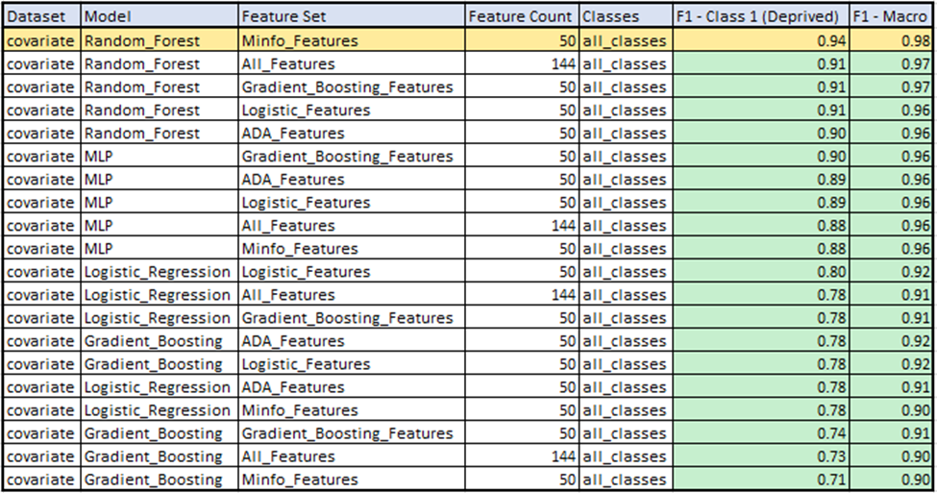
Model Testing: Covariate - all classes
4 model types tested:
Multilayer Perceptron
Random Forest
LogisticRegression
Gradient Boosting
train/test/val split: 60/20/20
GridsearchCV used for hyperparameter tuning
Top 50 features in each feature reduction set tested
Best performing model:
Random Forest
Top 50 Mutual information features

Slide 46
Best Model: Covariate - all classes
Covariate Confusion Matrix - All Classes
Best Performing Covariate Model on All Classes
Dataset | Model | Feature Set | Feature Count | Classes | F1- Deprived | F1- Macro
covariate | RF | Minfo | 144 | all classes | 0.94 | 0.98
True | Built-up | 3059 | 0 | 11
 | Deprived | 2 | 46 | 4
 | Non-built-up | 18 | 0 | 5975
 |  | Built-up | Deprived | Non-built-up
 | Predicted
(Confusion Matrix for the best performing model trained on the full covariate features dataset containing all instances of the Built-up (0), Deprived (1), and Non-built-up (2) classes )

Slide 47
Conclusion

Slide 48
Table of Contents
Introduction (3-5)
Problem statement
Data
Flow of Analysis
Contextual Features (6-24)
Extraction/Preprocessing
Feature Importance
Feature Ranking
Model Development
Covariates (25-46)
Extraction/Preprocessing
Feature Importance
Feature Ranking
Statistical Analysis
Model Development
4) Conclusion (47-52)
5) Discussion (53-55)
Original Raw Image of Lagos, Nigeria
Original Raw Image of Lagos, Nigeria

Slide 49
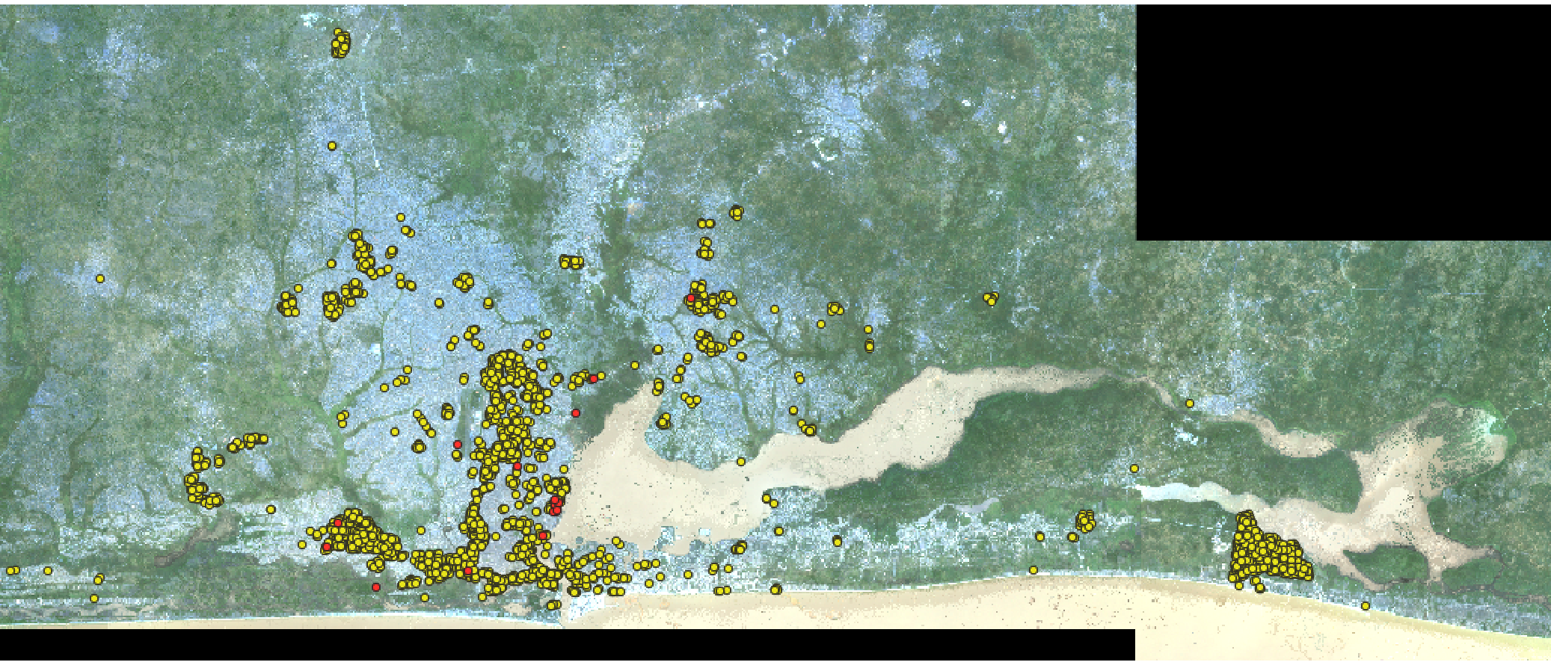
Conclusion: Problem Statement
Best Performing Models
There were two questions the researchers hoped to address in this study:
Can feature importance methods derive any contextual or covariate features that are useful in identifying ‘Deprived’ and ‘Built-up’ areas?
Feature importance methods based on Mutual information, Random Forest, Gradient Boosting, Logistic regression, and Adaptive boosting were able to identify the ranks of Contextual and Covariate features
Top Covariate feature: ‘uu_bld_den_2020’
Proved statistically that top 21 Covariate features were significant
Through the use of classical machine learning models and statistical analysis, are contextual and/or covariate features useful in identifying ‘Deprived’ and ‘Built-up’ areas?
Covariate features were useful
Contextual features were not useful
Dataset | Model | Feature Set | Feature Count | Classes | F1- Deprived | F1- Macro
covariate | MLP | All | 60 | classes 0&1 | 0.96 | 0.98
covariate | RF | Minfo | 50 | all classes | 0.94 | 0.98
contextual | GB | All | 144 | classes 0&1 | 0.35 | 0.67
contextual | MLP | All | 144 | all classes | 0.25 | 0.70
MLP: Multilayer Perceptron
RF: Random Forest
GB: Gradient Boosting
Predicted Deprived -
Predicted Built-up -
*https://unstats.un.org/sdgs/report/2019/goal-11/

Slide 50
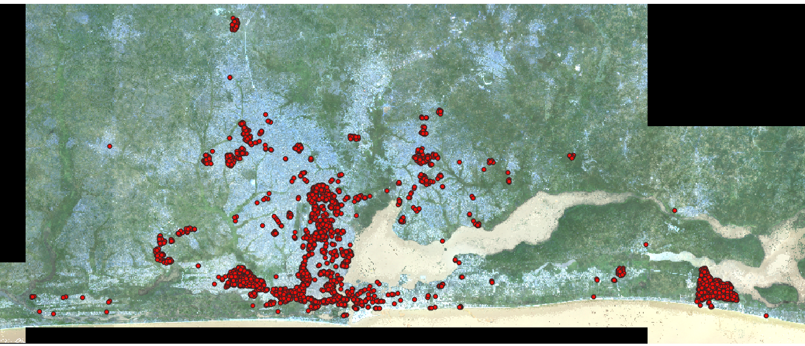
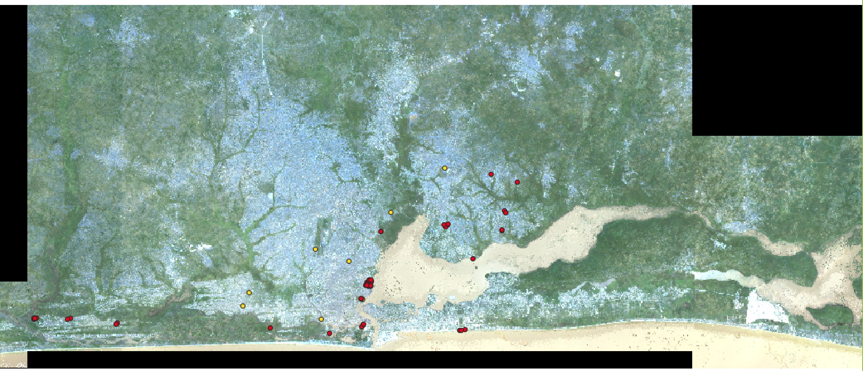
Contextual Model mainly predicted all labels as Built-up… that is why no yellow values are visible
Actual Built- up -
Predicted Deprived -
Actual Deprived -
Predicted Built-up -
*https://unstats.un.org/sdgs/report/2019/goal-11/

Slide 51
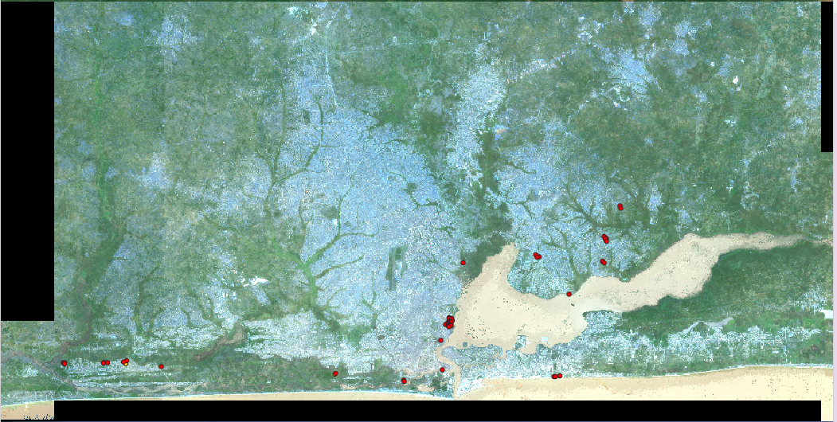
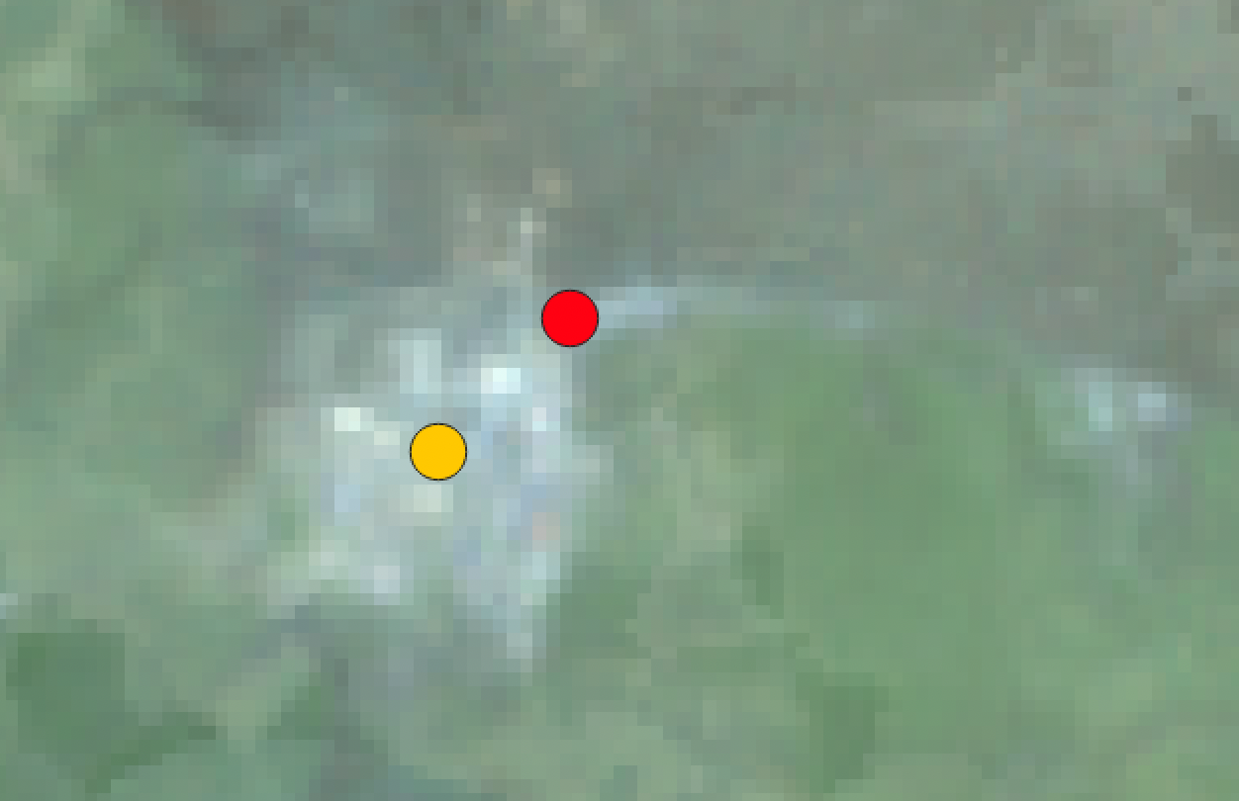
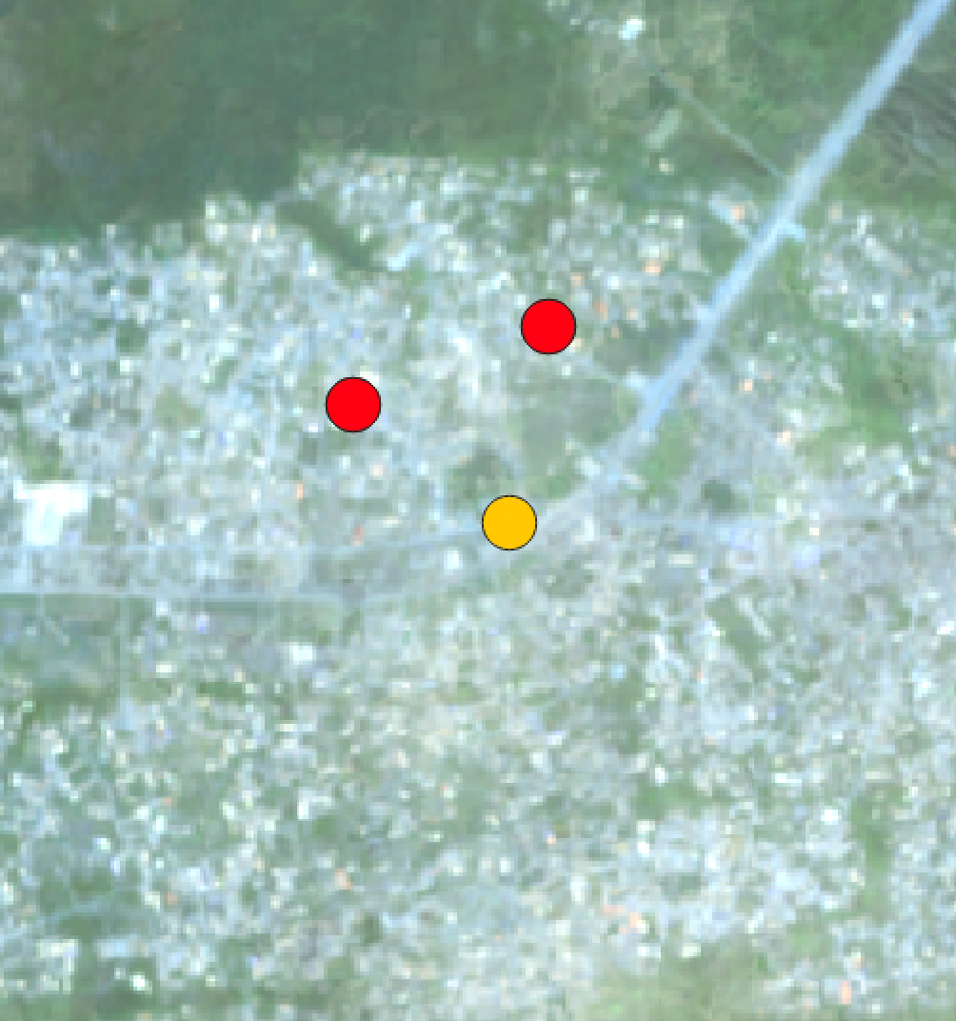
For the Covariate MLP model, there were only two mismatch labels for Deprived
Actual Deprived -
Predicted Bult- up -
*https://unstats.un.org/sdgs/report/2019/goal-11/

Slide 52
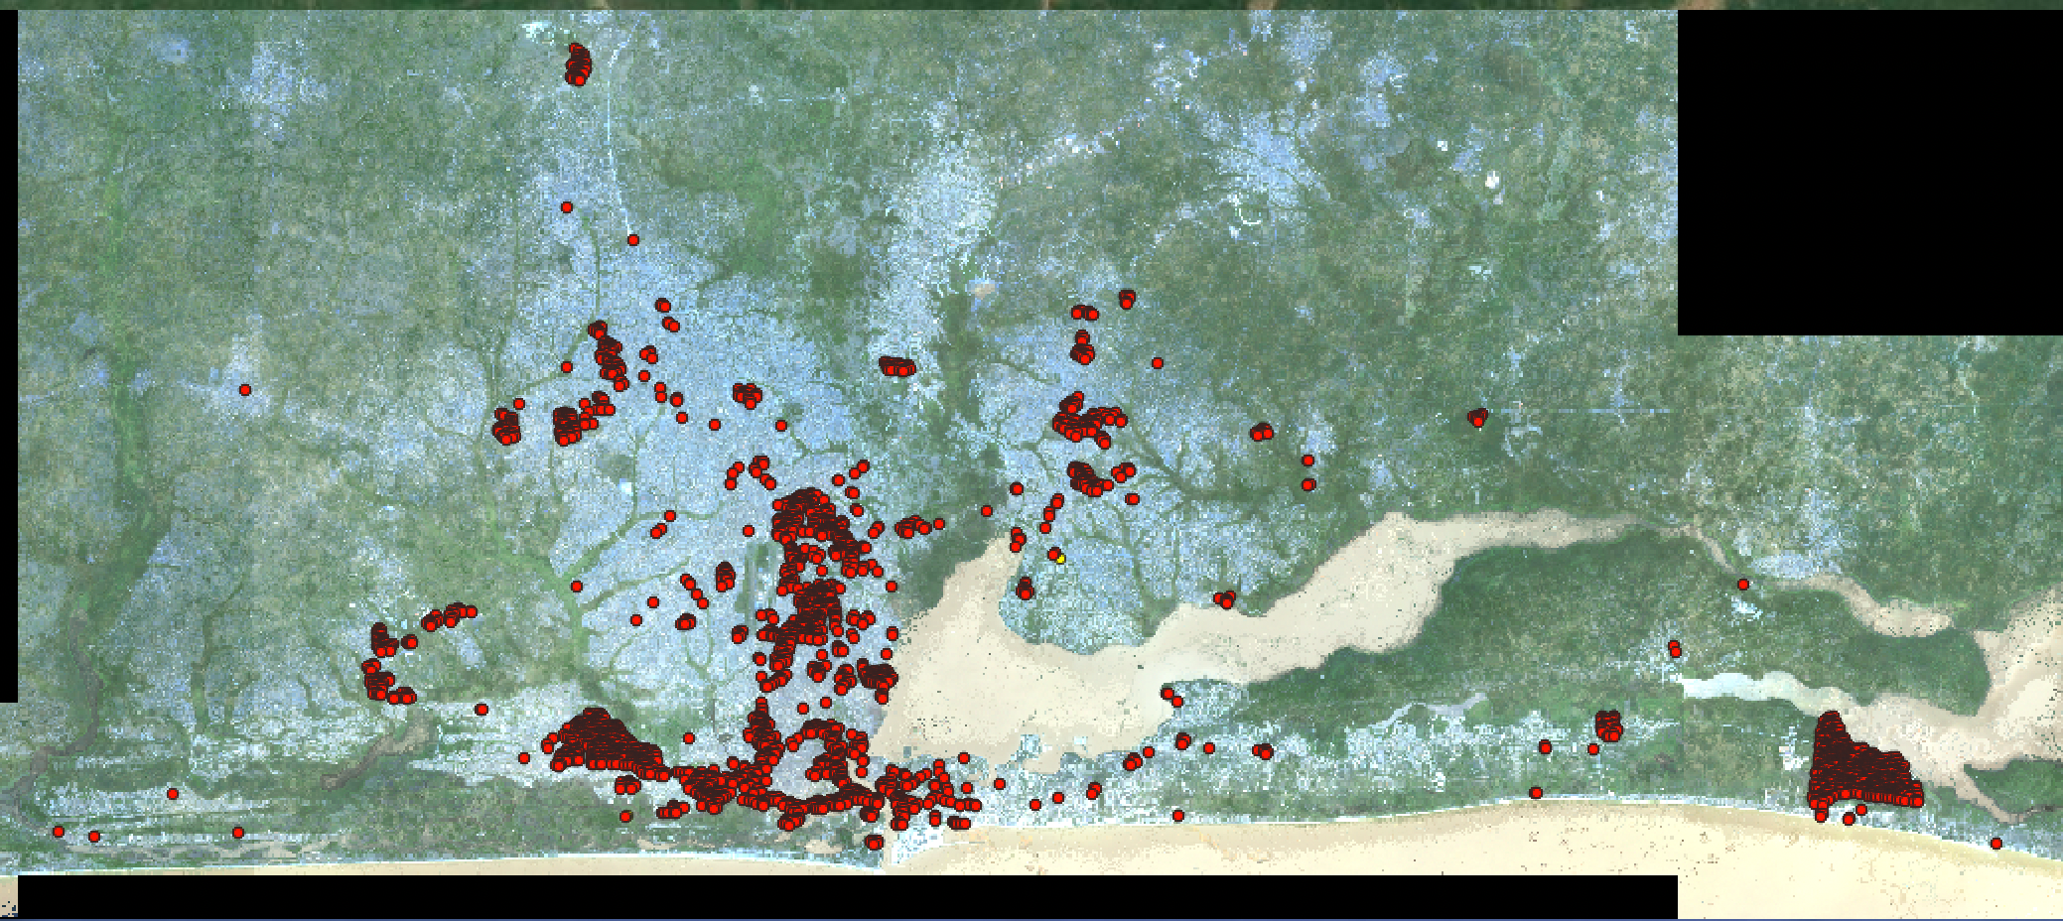
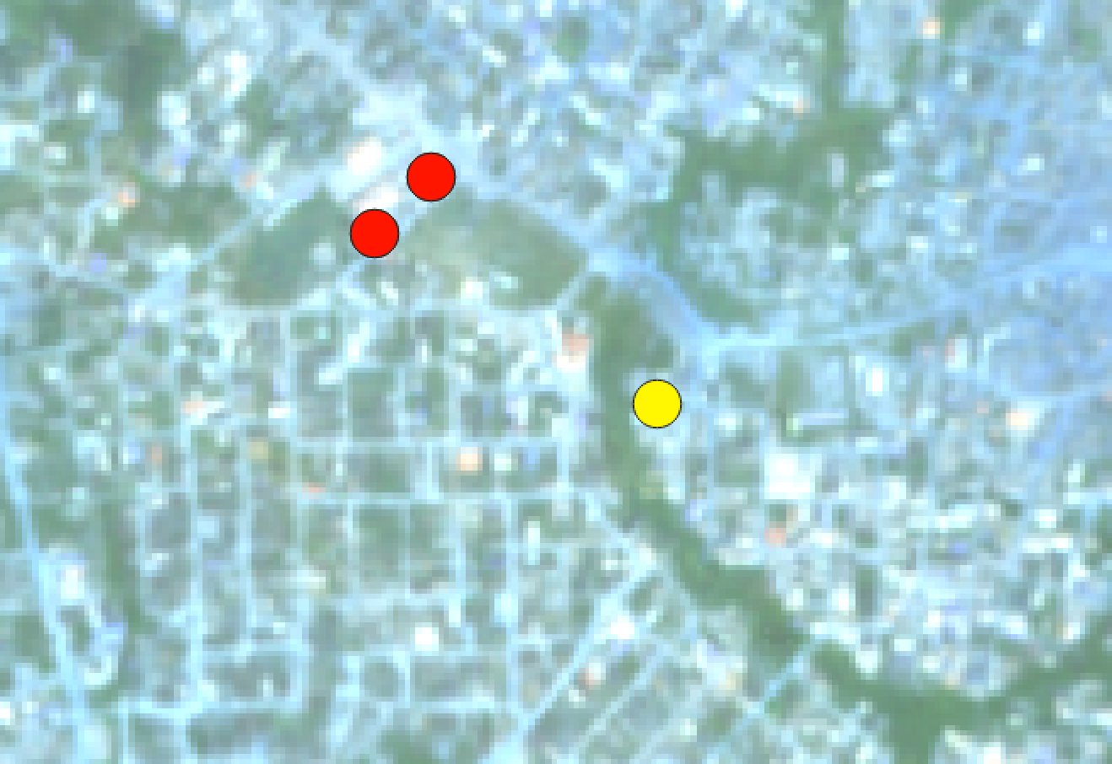
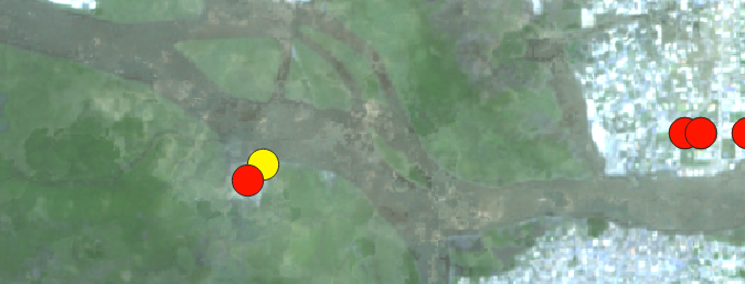
For the Covariate MLP model, there were only two mismatch labels for Built-up
Actual Built-up -
Predicted Deprived -
*https://unstats.un.org/sdgs/report/2019/goal-11/

Slide 53
Discussion

Slide 54
Table of Contents
Introduction
Problem statement
Data
Flow of Analysis
Contextual Features
Extraction/Preprocessing
Feature Importance
Feature Ranking
Model Development
Covariates
Extraction/Preprocessing
Feature Importance
Feature Ranking
Statistical Analysis
Model Development
4) Conclusion
5) Discussion
Introduction (3-5)
Problem statement
Data
Flow of Analysis
Contextual Features (6-24)
Extraction/Preprocessing
Feature Importance
Feature Ranking
Model Development
Covariates (25-46)
Extraction/Preprocessing
Feature Importance
Feature Ranking
Statistical Analysis
Model Development
4) Conclusion (47-52)
5) Discussion (53-55)
Original Raw Image of Lagos, Nigeria

Slide 55
Discussion
Add more ‘Deprived’ areas to analysis to address class imbalance
Attempt different processing steps for extracting the contextual features
Taking max, min, or median values
Investigate outliers/ apply transformations within ‘Deprived’ and ‘Built-up’ covariate features to further confirm statistical analysis
*https://unstats.un.org/sdgs/report/2019/goal-11/

Slide 56
Questions?

